Slide 1

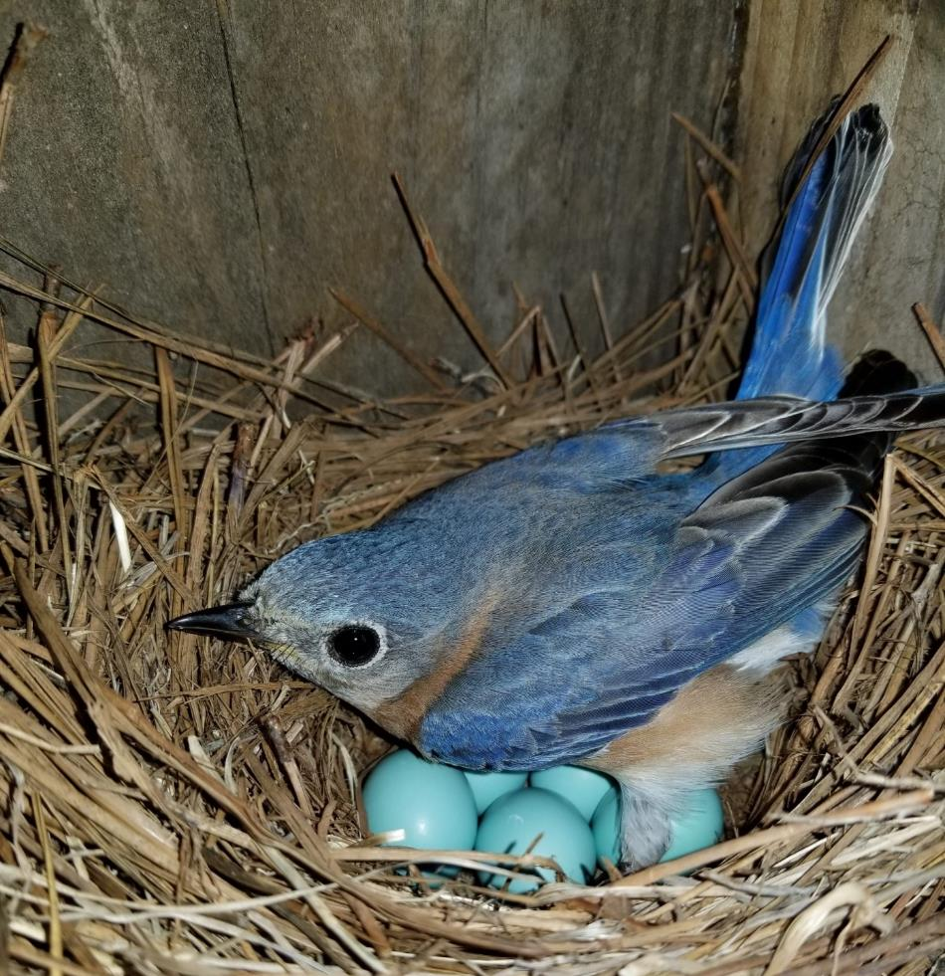




Slide 2
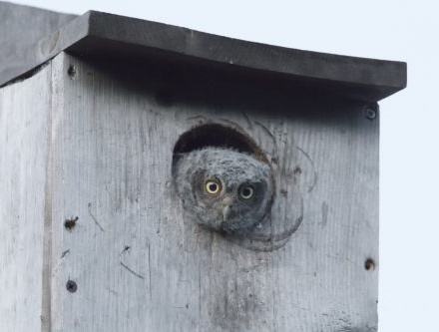
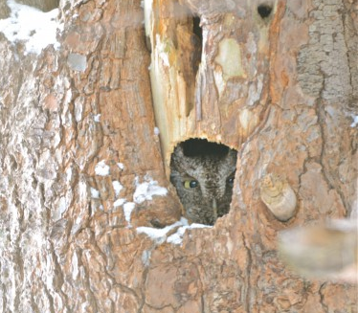
Why nest boxes?
From a bird’s perspective:
Nest box
Tree cavity
=
Notes:
From a bird’s perspective, a nest box and a tree cavity are similar. They both provide a place to nest and protection from weather and predators. Cavities often form in “snags” which is the term ecologists use for “standing dead tree.”

Slide 3
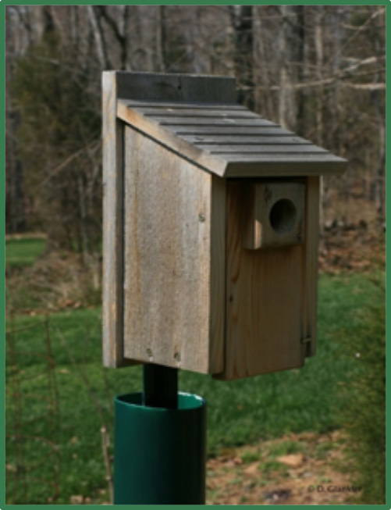
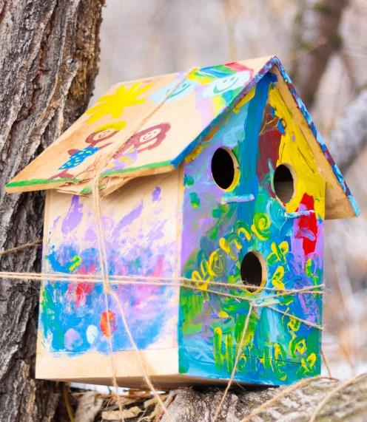
What makes a good nest box?
Good ☺
Bad ☹
Sloped roof
Box too small
3 holes = no
Perches = access for predators
Entrance hole is correct size
Door opens
Made with untreated wood. Probably cedar or pine.
Painted
Secured to tree with string
Box glued shut
Predator Guard
Notes:
A good nest box or birdhouse is made from wood that isn’t treated with chemicals. Usually the wood is cedar, pine, or cypress. These types of wood last the longest. The nest box is not painted. Paints can release chemicals which are not good for birds. Also, painted boxes stand out in the environment and can attract predators.
Good nest boxes are screwed together (not nailed) and have an entrance door that can be opened. Having a door that opens allows you to check the nest box and clean out old nests at the end of the nesting season.
Good nest boxes also have predator guards to prevent animals like raccoons, chipmunks, and cats from getting into the nest box.
Good nest boxes have a sloped roof to shed rain and a recessed floor with drainage so that water does not stay in the nest box.
Good nest boxes are also the appropriate size with the right size entrance hole for the bird that you want to attract to the nest box. The good box pictured above is meant for bluebirds and swallows, but would also attract chickadees and wrens.
The bad nest box in the picture is meant for decoration. It has too many entrance holes and the box is glued shut. It is also painted bright colors which may attract predators. There are perches on the front of the nest box. Birds do not need a perch. The perch is a good way for predators to get into the box.

Slide 4
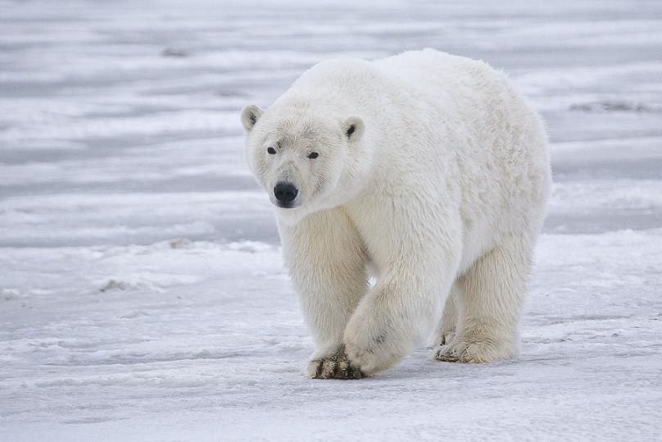
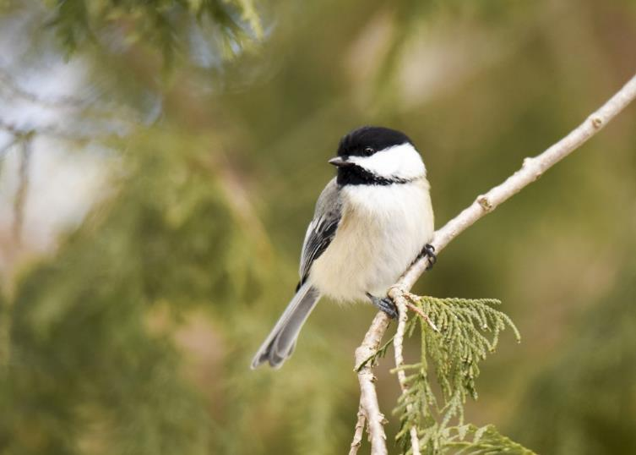
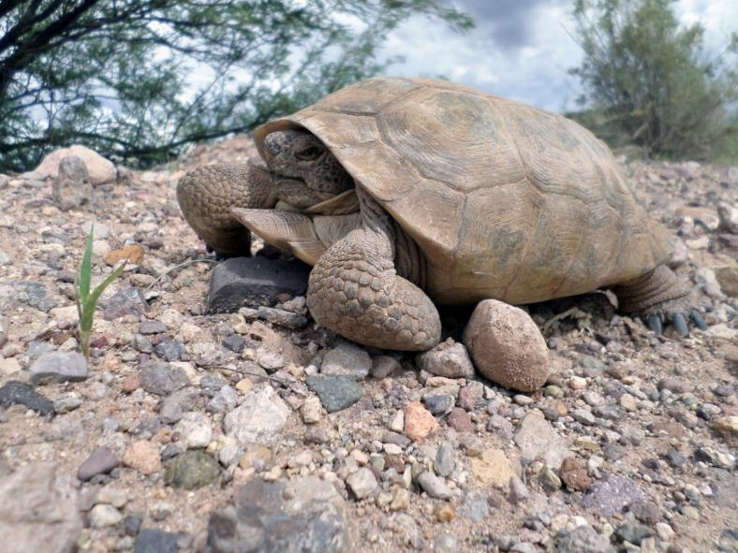
What is a habitat?
Notes:
The area in which an animal lives; can be described by the sources of food, water, cover (shelter), space to move about. Animals such as a polar bear prefer what type of habitat? Where would this desert tortoise prefer to live? Just like these animals can be found in a specific habitat, birds also prefer different habitats. This chickadee resides in forests, parks, and near people’s houses.

Slide 5
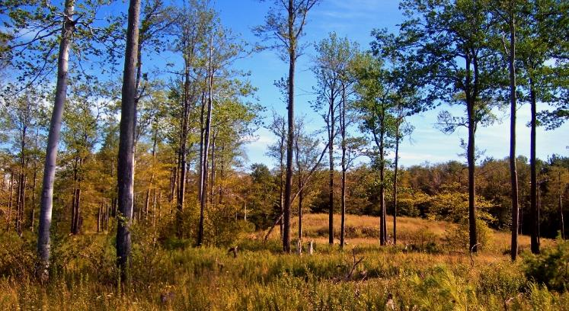
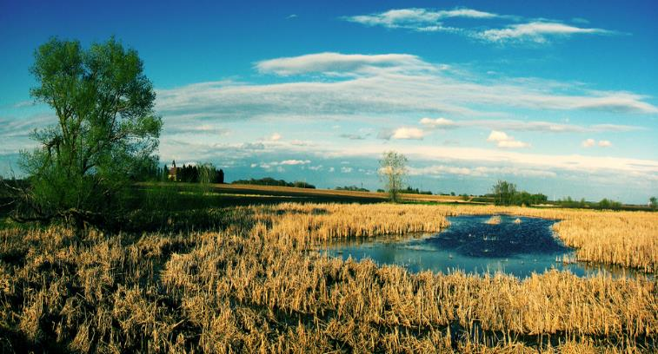
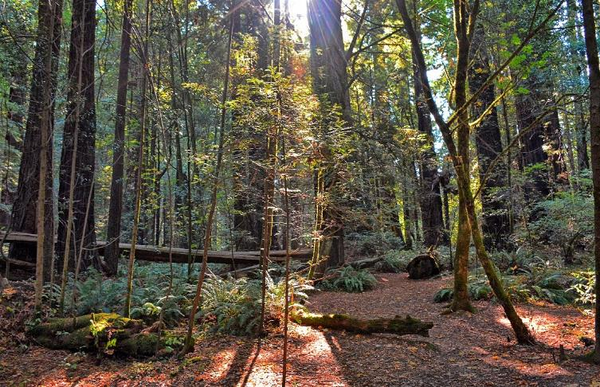
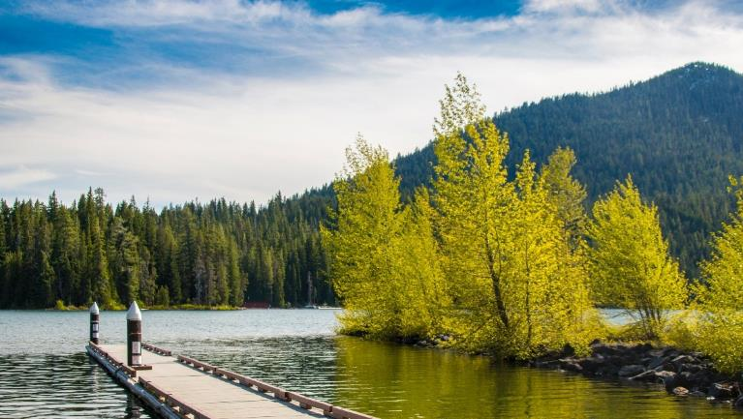
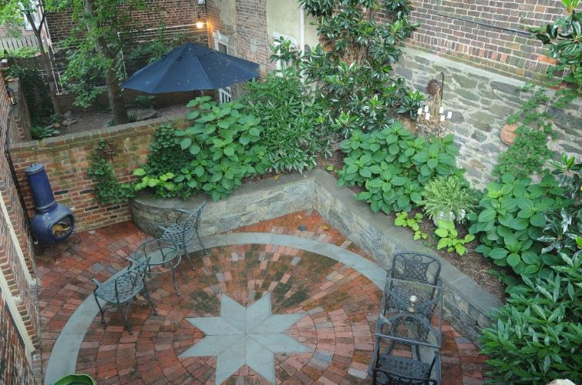
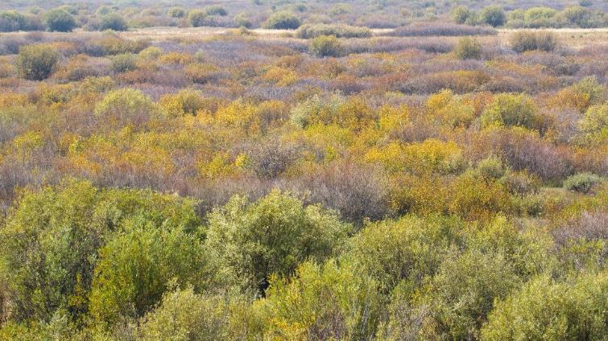
Open Woodland
Wetland
Lake
Forest
Town or City
Shrub
Notes:
These are a few examples of habitats. There are many other habitats that are not pictured. What habitats do you see in these photos? Clockwise from upper left: open woodland, wetland, forest, shrub, town/city, lake. You can finding nesting birds in all of these different habitats.
Open woodland – An area that has a low density of trees and canopy is open, allowing for sunlight to penetrate to the forest floor.
Wetland – An area that is saturated with water either permanently or seasonally.
Forest – Dominated by deciduous and/or coniferous trees, generally with a distinct canopy, though it can have some open areas.
Shrub – An area that is a thicket of shrubs and young trees, also contains grasses and wildflowers.
Town & City – An area characterized by houses, streets, and parks.
Lake – An area of variable size that is filled with water, localized in a basin.

Slide 6
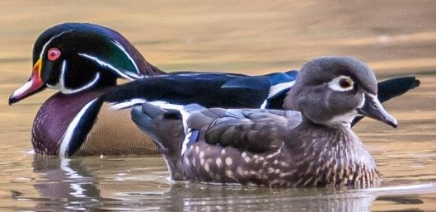
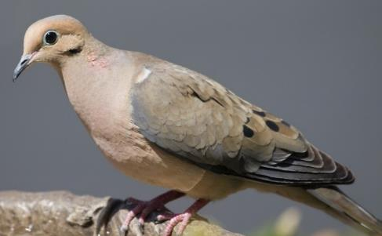
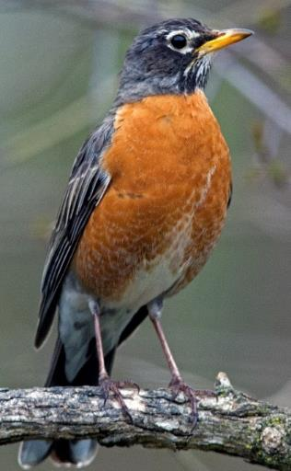
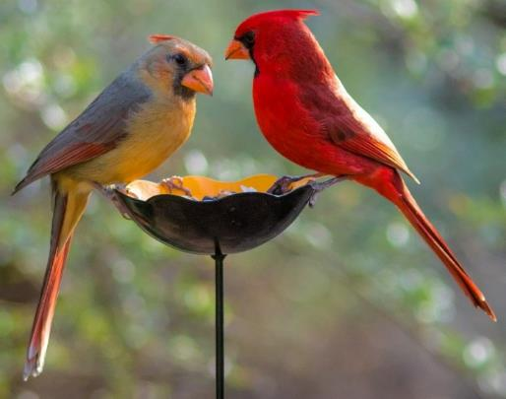
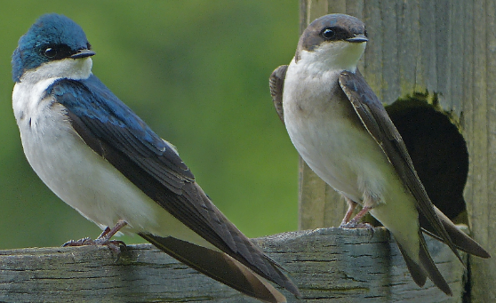
Right Bird, Right Habitat
Where do these birds nest?
(Hint: They might nest in several different habitats.)
Notes:
Ask youth which habitats from the last slide these birds might nest in. Feel free to go back and forth between this slide and the previous slide to help guide their decision making.
To get more information about each species, use the NestWatch Common Nesting Birds guide: https://nestwatch.org/learn/focal-species/. Birds might nest in several different habitats.
Northern Cardinals– Open woodland, shrub, town/city
Wood Ducks– Lake or wetland
American Robin– Forest, open woodland, shrub, town/city
Mourning Dove– Town/city, forest, open woodland
Tree Swallows– Wetland, lake

Slide 7






The Nesting Cycle
Find and defend a territory
Find a mate
Build a nest and lay eggs
Incubate eggs
Feed and raise nestlings
Nestlings fledge from the nest
Nesting Cycle
Notes:
Birds go through 6 major stages during their breeding cycles: find and defend a territory, find a mate, build a nest and lay eggs, incubate, feed and raise nestlings, and fledge from the nest.
(More details on next slides…)

Slide 8
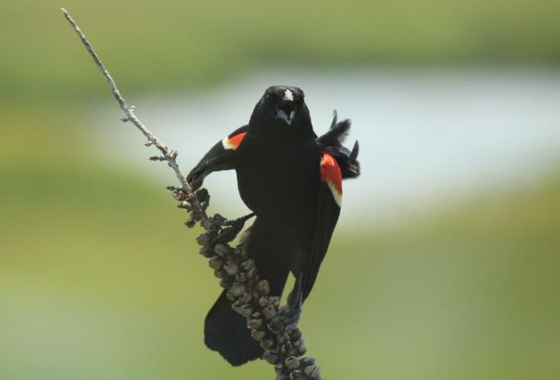
Find & Defend a Territory
Nearly all birds defend a breeding territory during their breeding season.
The breeding territory contains the resources needed to live, nest, and raise young.
It may be very small in the case of individuals that are part of a breeding colony.
Nesting Cycle
Notes:
Before a bird builds its nest, it must first find a suitable area, called a breeding territory, to build the nest and raise its young in. Nearly all birds defend some sort of breeding territory during their breeding season, and for good reason. A good breeding territory contains all of the resources that the birds will need during the nesting period, including food, water, and protection from predators, so birds want to keep other birds that would be using those same resources out of their territory. Many birds, including most songbirds like warblers, thrushes, and sparrows, don’t leave their breeding territories at all during the breeding season.
Red-winged Blackbirds are very common, and very territorial birds. If you live almost anywhere in North America, chances are you’ve seen this bird. If you see Red-winged Blackbirds regularly, you’ve probably seen a male defending his breeding territory at some point. In this photo, this male Red-winged Blackbird is performing a classic aggressive display. The males of this species have adapted special red patches on their wings that are used to signal to other Red-winged Blackbirds that they’d better not move into his territory. This guy is also in the middle of an aggressive call as part of his display.
The exception is colony-nesting birds. In a dense breeding colony (e.g., seabirds breeding on coasts), a “territory” may be no larger than the bird’s own body size, and nests may be only as far apart as the size of the adult’s body.

Slide 9
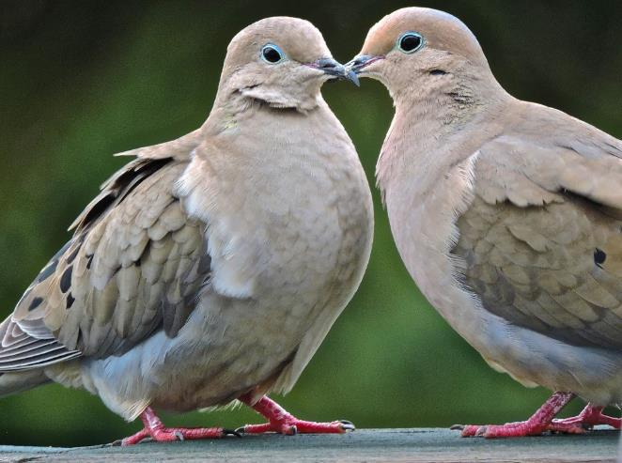
Find a Mate
Males can go to great lengths to find a mate.
  Song & aerial displays
  Nest site selection
  Nest building
  Feeding their mates
Nesting Cycle
Notes:
Generally males get the responsibility to attract a female, and they may do so by singing, displaying their feathers, showing potential nest sites to females, offering gifts of food to females, etc. Females then typically have the responsibility of doing the majority (if not all) of caring for the young. The reverse situation (called “polyandry”), in which females display for males, is relatively rare in birds. Exceptions include the phalaropes, in which females are more brightly colored and abandon their eggs to the male’s care.

Slide 10
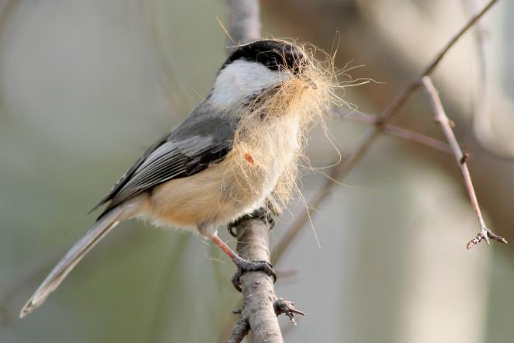
Build a Nest
Birds use a huge variety of materials to build nests.
  Twigs and sticks
  Dead leaves
  Pebbles
  Mud
  Hair, fur, feathers
Nesting Cycle
Notes:
Once a bird has found a suitable breeding territory, it can then begin building its nest (if it’s a nest-building species). The amount of time a bird spends building its nest and the materials it uses to build it are as diverse as the variety of birds.
This Black-capped Chickadee is gathering hair to use to build its nest!
[You may wish to talk about some familiar nesting materials and some stranger ones.]

Slide 11
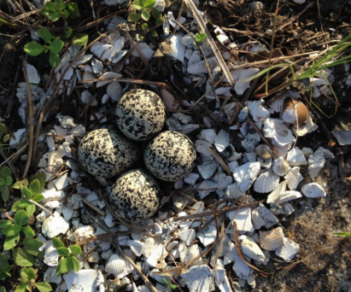
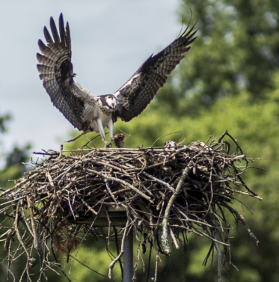
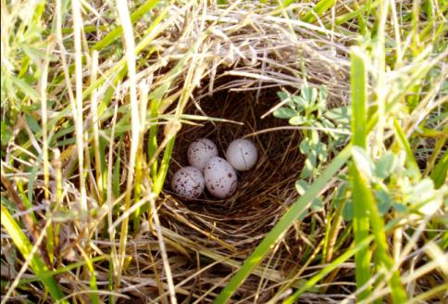
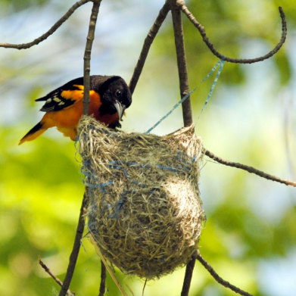
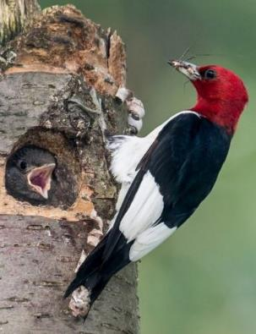
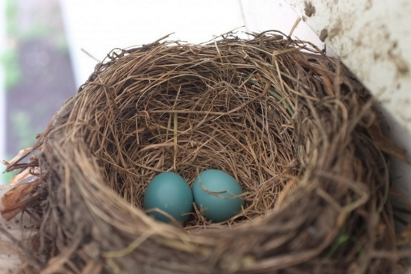
Types of Nests
Scrape
Platform
Dome
Pendant
Cavity
Cup
Nesting Cycle
Notes:
Birds build a diverse variety of nests. The “classic” bird nest is the cup nest. You might have already guessed it from the famously blue eggs which nest is that of an American Robin. Baltimore Orioles build a different type of cup nest, called a pendant nest because it hangs like a pendant on a necklace from tree branches. Ospreys build large platform nests that have only a shallow depression. Some birds, like the Eastern Meadowlark that made the nest in this photo build domed nests that are covered on the top. Woodpeckers, like this Red-headed Woodpecker, nest in holes that they excavate in trees. Other birds, like Killdeers, hardly build nests at all. They just clear a space on the ground and create a shallow depression called a scrape. Some birds, like the Killdeer, line the scrape with some smooth pebbles, but many don’t use any nest material at all.
Another nest not pictured is a burrow underground. Burrowing Owls can dig their own nests or use burrows of tortoises or prairie dogs.
Some birds don’t build a nest (Vulture) and some birds reuse other birds nests (Great Horned Owl).
These are just a sampling of some of the many different bird nests that are found in North America alone.

Slide 12
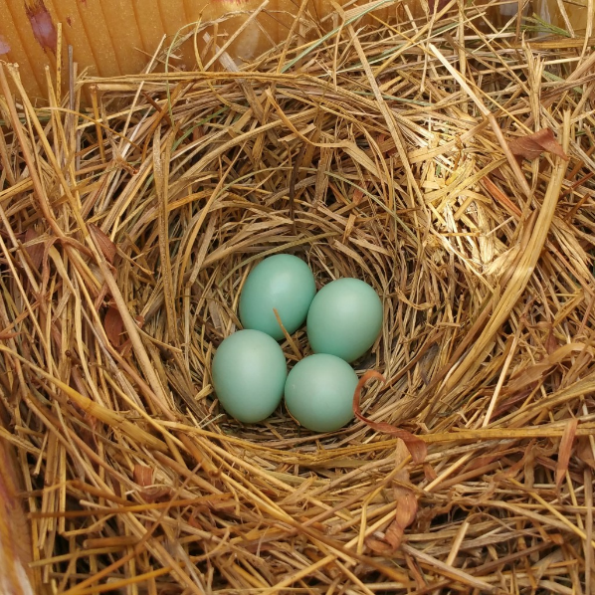
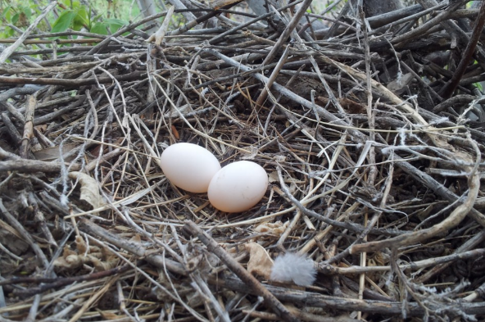
Lay Eggs
The set of eggs laid by a female during a single nesting attempt is called a clutch.
Laying time varies.
Nesting Cycle
Notes:
The number eggs laid by a female during a single nesting, called a clutch, varies greatly among bird species. The photo on the right is of a clutch of Eastern Bluebird eggs. Four is a typical clutch size for songbirds like the Eastern Bluebird. Most songbirds lay between 2 and 6 eggs. The photo on the left is of a clutch of Mourning Dove eggs. Doves, pigeons, and hummingbirds almost always lay just two eggs.
Some birds take longer to lay their eggs than others. In general, larger birds take longer to lay eggs than smaller birds do. Brood parasites like Brown-headed Cowbirds are often an exception to this general rule though– since they lay their eggs in the nests of other birds, they have to do it quickly before the real parent birds return.
Birds don’t lay all of their eggs at once (unless, of course, they only lay one egg!). Some birds lay eggs only 24 hours or less apart, but others wait as long as a week before laying their next egg.

Slide 13
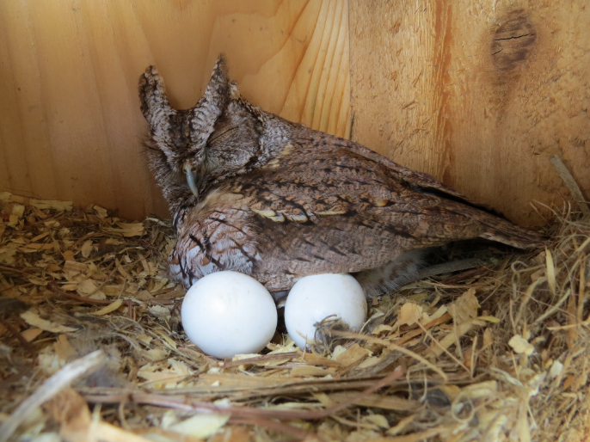
Incubate Eggs
Developing chicks must be kept at a certain temperature.
When an adult bird sits on its eggs or young to warm them, it is called brooding.
Nesting Cycle
Notes:
Developing chicks must be kept at a certain temperature in order to survive. Most birds accomplish this by brooding, which is when birds sit on their eggs or newly hatched young in order to keep them warm. A few days before a female lays her first egg, some of the feathers on her belly fall out to form an incubation patch, or brood patch, an adaptation for brooding. Having bare skin in contact with the egg rather than feathers is a more efficient way to warm the eggs. [Note: not all birds develop a brood patch, and in some species, males also develop one.]

Slide 14
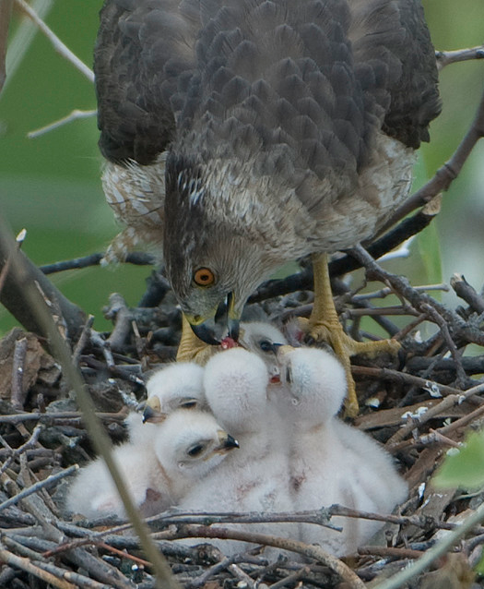
Chicks Hatch
Chicks use an egg tooth to break through the shell.
The process of breaking through the shell is called pipping.
Egg tooth
Nesting Cycle
Notes:
These Cooper’s Hawk chicks just recently hatched! Even though these chicks are already fluffy and have their eyes open, you can tell that they are newly hatched because they still have an egg tooth (small and white on the chick’s beak in the photo above). When the chick is ready to hatch, it rubs its egg tooth along the inner wall of the egg until it breaks through. The process of breaking through the eggshell is called pipping (what a great word ☺). The egg tooth usually either falls off or is reabsorbed.

Slide 15
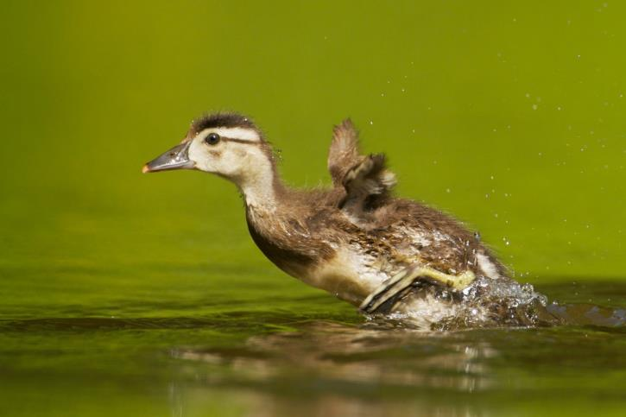
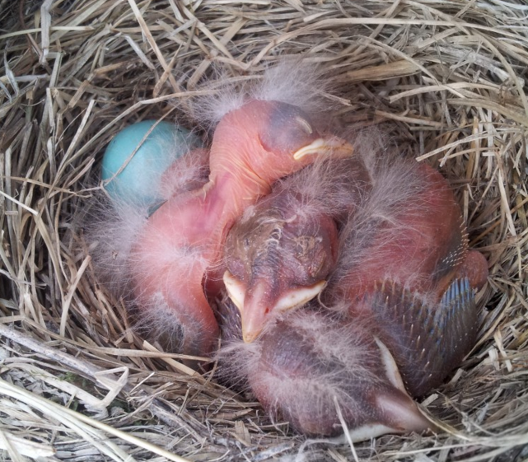
Hatchlings
Precocial hatchlings are more developed and independent.
Altricial hatchlings are completely dependent on the parents.
Nesting Cycle
Notes:
Not all birds are quite so cute and fluffy as Cooper’s Hawks chicks are right after they hatch. Many birds of prey, like the Cooper’s Hawk, as well as shorebirds and waterfowl, have precocial young. Precocial hatchlings, like this Wood Duck, are much more developed and less dependent on their parents. Most songbirds, on the other hand, have altricial young, which aren’t quite so cute and fluffy right away. Altricial young, like these American Robin chicks, are far less developed at the time of hatching and are completely dependent on their parents.

Slide 16
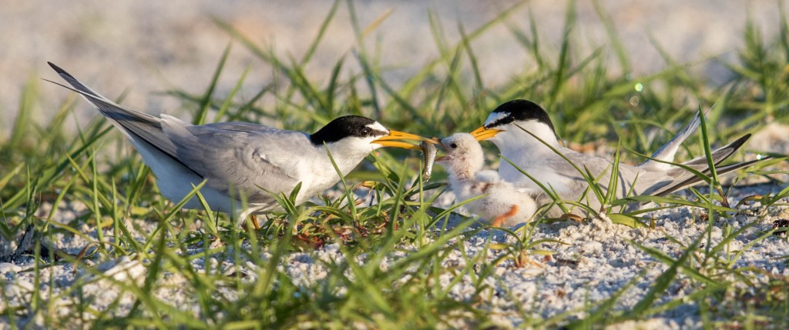
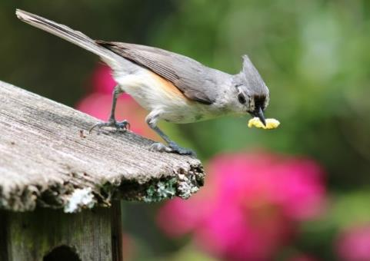
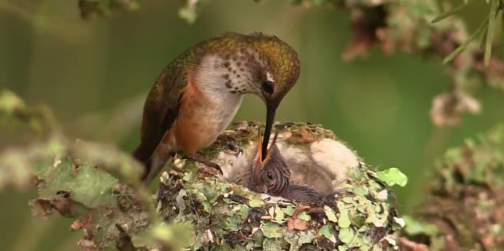
Feed & Raise Young
Nesting Cycle
Notes:
All altricial young, and even most precocial young, rely on their parents to bring them food or help them find food. Food is what provides all animals with the energy they need to drive life processes, but baby birds especially need to eat lots of food to provide them with the energy they need to grow and develop. Because of this, many species of birds feed their chicks a special, high-nutrient diet that is different from what they’ll eat as adults.
Other species of birds feed their young the same kind of diet that they’ll eventually eat as adults.

Slide 17
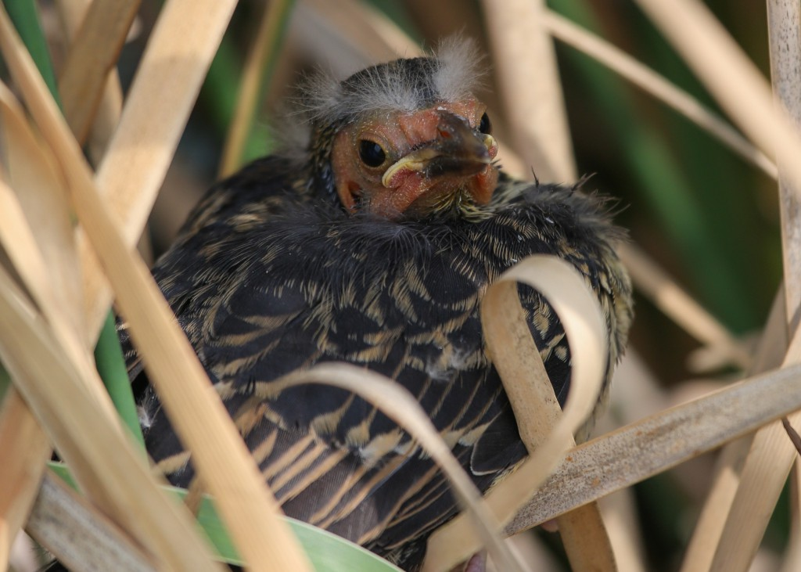
Fledging from the Nest
Fledging is when a nestling:
  is able to leave the nest, but is not necessarily fully capable of flight;
  has acquired its first complete set of flight feathers.
This term is usually used for altricial nestlings.
Nesting Cycle
Notes:
‘Fledging’ is something of a loose term. It is often used to describe young birds like this Red-winged Blackbird, who have left the nest but whose flight feathers haven’t quite finished coming in yet. But a juvenile bird that has already acquired a full set of flight feathers can also be referred to as a fledgling. A fledgling is a young bird that has only recently fledged, or left the nest. This term is most often used for altricial young that need to be reared in the nest for extended periods of time. Most precocial young ‘fledge’ almost immediately (e.g., mallard young are herded to the water within 16 hours of hatching).

Slide 18
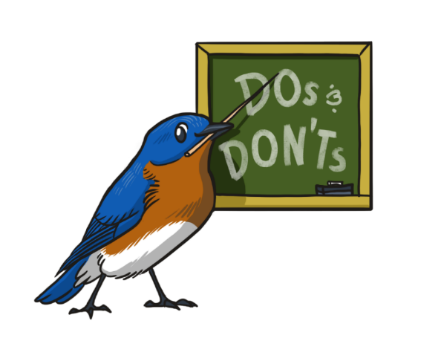
Get Certified
Following the NestWatch Code of Conduct will help you minimize risk of accidental harm to a nest, parents abandoning the nest, or attracting predators to the nest.
Code of Conduct
Notes:
Please exercise caution when monitoring nests to ensure the safety of birds nests and eggs.

Slide 19


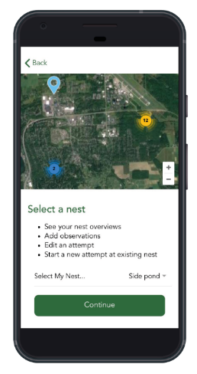
Plan ahead for nest visits
Plan to observe the nest every 3-4 days.
Most successful songbird nests last about 30 days, so you may need to visit each nest 7-10 times.
Nest visits should last no
longer than 1 minute.
Code of Conduct
Notes:
Checking the nests every 3-4 days allows you to collect good information about the nesting cycle without causing too much stress for the birds. You can record your nest checks on a data sheet and enter them online or download the NestWatch app from the Apple App Store or Google Play. If you use the app, you can enter your data as you visit nests.

Slide 20
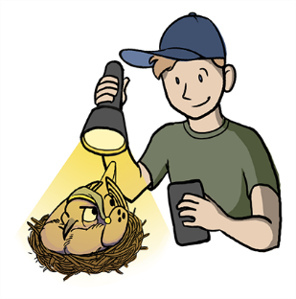
Do NOT check nests in the early morning or late evening
Most birds lay their eggs in the early morning.
Birds also stay on the nest at night.
Owls are the exception. You can check their nests near sunset.
Code of Conduct

Slide 21
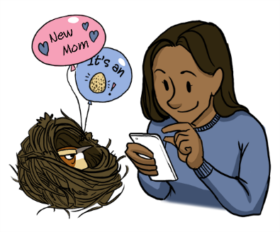
Avoid nests during early incubation
Females do not like to be disturbed in the first few days of incubation.
If possible, observe nests from a distance and approach only when the female leaves the nest.
Code of Conduct

Slide 22
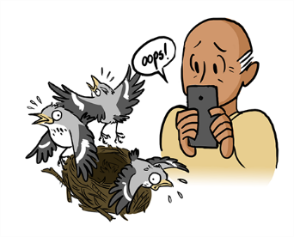
Do NOT approach nests when young are close to fledging
  When young are bothered during this stage, they may leave the nest before they are ready.
  Young that prematurely fledge usually do not stay in the nest even if you try to return them.
Code of Conduct

Slide 23
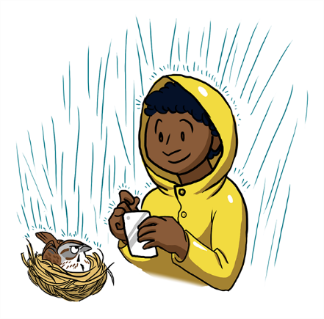
Avoid nests during bad weather
If it is cold, damp, or rainy, postpone checking nests until another day.
Code of Conduct

Slide 24
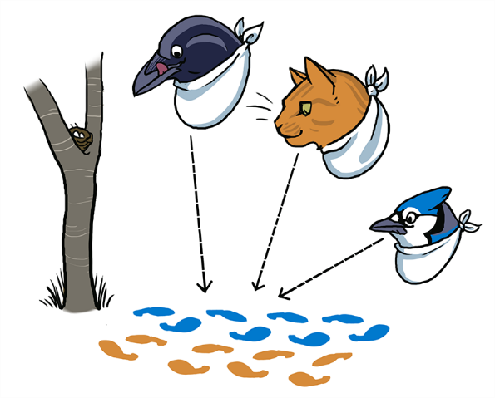
Don’t lead predators to the nest
Avoid leaving tracks that can lead predators to nests (e.g., a flattened trail of vegetation leading straight to the nest).
You can avoid making a dead-end trail of trampled grass by taking different routes to the nest each time.
Code of Conduct

Slide 25
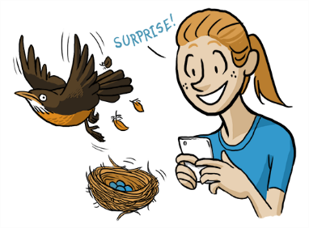
Approach nests with care
Before approaching the nest, try to see if a parent is sitting on it.
Whenever possible, wait a few minutes to see if the bird leaves on its own. If it does, proceed to check the nest.
If the bird flushes, give it time to fly off the nest.
Open nest box doors slowly and quietly.
Code of Conduct

Slide 26
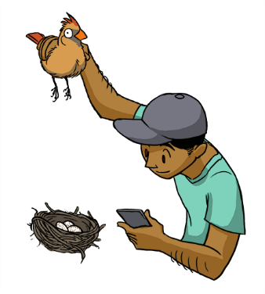
Do NOT force a bird off the nest
If a sitting bird does not leave on its own, do not force it off the nest.
Make a note and move away from the nest before recording your visit.
Code of Conduct

Slide 27
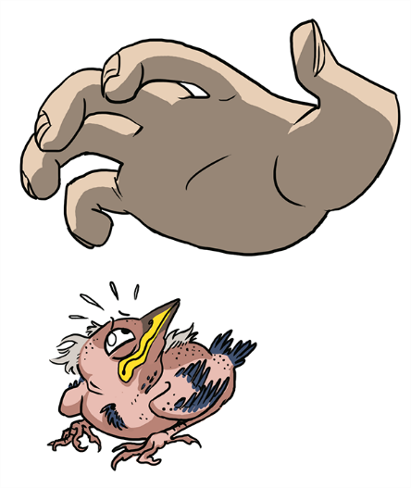
Do NOT handle birds or eggs
It is against the law and unnecessary to touch eggs or birds.
Eggs and nestlings are fragile and can easily be damaged or hurt.
Only people with special permits can handle eggs and birds.
Code of Conduct

Slide 28
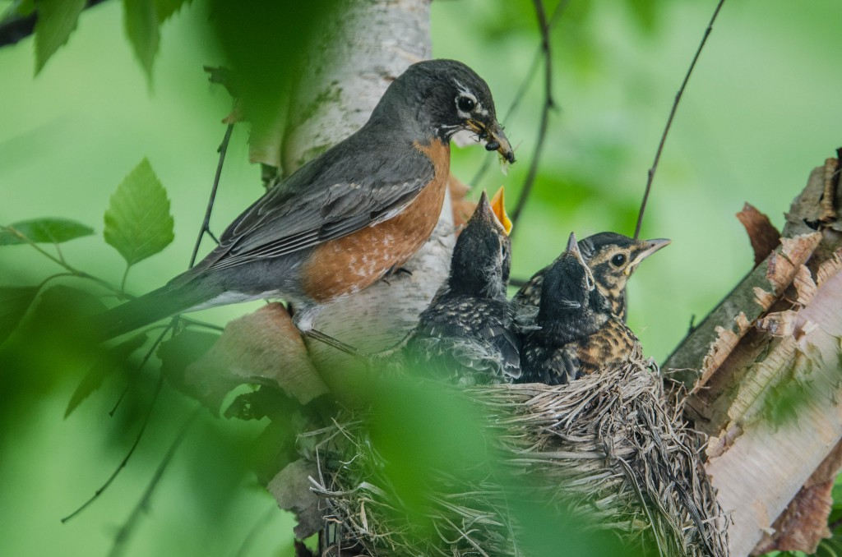
Time to play BINGO!
Notes:
Play NestWatch Bingo to review nesting cycle & get certified to be an official NestWatcher!

Slide 29
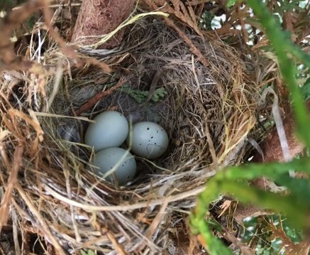





Find Nests!
House Wren
House Finch
Gray Catbird
Northern Cardinal
Barn Swallows
Carolina Chickadees
Find and Monitor Nests
Notes:
Whether you find a nest in a nest box, in a tree, or attached to a building, be sure to note the different nesting materials. Sometimes the differences can be more subtle. For instance, nests of cardinals and catbirds may at first appear the same and both are placed in the middle of a dense shrub, however upon closer examination you will see that cardinal nests are built out of finer grassy material and catbird nests are built out of thicker sticks. Their eggs are very differently colored, which is another clue to nest identification. A nest made with mud attached to a structure is likely a phoebe or a Barn or Cliff swallow nest.
These differences in nest structure also apply to species that nest in nest boxes. A House Wren nest will have lots of sticks and feathers in the nest bowl, but a chickadee nest will contain fur and moss.

Slide 30


During nest building:
birds will show you the way;
follow birds carrying grass, twigs, etc.;
once you find the nest site, move away!
Find and Monitor Nests
Notes:
It’s often more effective to let the birds show you where their nests are rather than simply looking for the nests themselves. Learning to interpret bird behavior can make finding nests much easier. Nest building is a particularly easy time to find nests, but give birds some room, because it’s also a time when they’re highly vulnerable to abandoning a nest that they haven’t invested much in.

Slide 31


During egg laying:
birds won’t lead you to their nests;
females only visit nest to lay eggs once a day.
Find and Monitor Nests
Notes:
During egg laying, birds want to be sneaky to avoid attracting the attention of predators to nest sites. They also only visit once a day to lay an egg, usually in the morning. It’s usually pure luck when you find one during laying (unless in a nest box).

Slide 32

During incubation:
females may seem to disappear;
males may increase singing;
watch for “flushing” birds–birds that burst out from a tree/shrub.
Find and Monitor Nests
Notes:
When searching for nests, watch for birds that jump off of nests at the last second and listen for harsh alarm calls that will let you know that you’re near a nest.

Slide 33


During nestling phase:
watch for frequent feeding trips and removal of waste;
listen for young begging for food.
Find and Monitor Nests
Notes:
The nestling period a very active phase of life at the nest. There will be lots of behavioral cues that you can use to locate active nests. Females are less likely to abandon nests at this point, but you should still keep visits short to minimize disturbance to the nestlings.

Slide 34


What can data tell us?
Mountain Bluebirds have good years
and bad years.
Dig Into Data
Notes:
Success means that at least one young fledged. Not all of the young have to fledge in order for the nest to be successful. Long-term average is the average calculated over a long period of time. This graph calculates the long-term average of Mountain Bluebirds between 1997-2015; that is 18 years of data collected! We can learn a lot from long-term data. See the next slide for an example.

Slide 35






When we have enough data for many years, we can see declines or increases in species.
Dig Into Data
Notes:
Long-term data show trends in populations. If a species is in decline, we can research the causes and devise solutions.

Slide 36
Nesting success
Year | % Successful
Year 1 | 88.4
Year 2 | 85.7
Year 3 | 87.3
Year 4 | 83.3
Year 5 | 82.5
Year 6 | 80.6
Year 7 | 79.0
Year 8 | 78.0
Year 9 | 72.0
Year 10 | 75.0
Year 11 | (From 1C) ____
Let’s assume you have data from 10 previous years on your focal species. Calculate the long-term average nesting success of this hypothetical dataset.
  Your answer from question 1C of the data analysis activity will be used for % successful in year 11.
Try graphing these data with year on the X-axis and percentage of successful nests on the Y-axis.
Dig Into Data
Notes:
Average _______________ (actual average will vary based on the answer to Question 1. The formula: add all numbers in the right-hand column and divide by 11.
Now we will graph years 1-11 individually or as a group. You could utilize a white board for the graphing.
After you are done graphing, ask if the trend is decreasing, increasing, or remained about the same? See Activity 5 Part 1, pages 29-30.

Slide 37


House Wren average clutch size
Northwestern nests had an
average of 1.7 more eggs
than Northeastern nests!
Clutch sizes for House Wrens differ from region to region.
6.3
4.6
6.0
5.5
5.0
Dig Into Data
Notes:
Which region had the highest average clutch size? The lowest? Have youth come up to the map.
Highest = northwestern region, at 6.3; lowest = northeastern, at 4.6
Which environmental factors might vary in a way that could influence clutch size?
Climate (temperature, precipitation), food availability
Questions from Activity 5 Part 2, page 32-33.

Slide 38
Comparing first-egg dates
Dig Into Data
Notes:
Looking at the graph, what species is most likely to have multiple broods per year? A brood is a group of young raised together at one time. Some birds only have one set of young, while others can have two or more.
The pattern of steady peaks indicates that Eastern Bluebirds are more likely to have two or even three broods a year. The single large peak for Tree Swallow indicates that it typically has only one brood per year.
What species is likely to migrate longer distances in the fall or winter?
We can infer from its later peak of egg-laying that the Tree Swallow is the longer-distance migrant. The farther a bird migrates in the winter, the longer it takes to return and start nesting in the spring.
Questions from Activity 5 Part 2, page 32-33.

Slide 39

That’s why we need your data!
Notes:
Collecting data and understanding how to use it are important to solving real world questions about birds! Thanks for your help!

Slide 40
Photo Credits
Slide 1: Eastern Bluebird by Craig Moody
Slide 2: Polar bear by Alan Wilson – Wikimedia Commons; Desert tortoise by Laura Patterson – Wikimedia Commons; Black-capped Chickadee by Betsy Bass
Slide 3: Open woodland - Nicholas A. Tonelli/Flickr/CC BY 2.0; Lake - Lessa Clayton/Flickr/CC0; Town or city - Serge Melki/Flickr/CC BY 2.0; Wetland - Varanos/Flickr/CC BY 2.0; Forest - Kirt Edblom/Flickr/CC BY-SA – cropped; Shrub - Tony Hisgett/Flickr/CC BY 2.0
Slide 4: American Robin by Gary Mueller; Northern Cardinals by Susan Bebee; Wood Ducks by Susan Jensen; Tree Swallows by Bob Vuxinic; Mourning Dove by Andrew Warren
Slide 5: Eastern Screech-Owl in nest box by Robert Strickland, Eastern Screech-Owl in tree by George Brehm
Slide 6: “Good” nest box by D. Glankler, “Bad” nest box by rcfalcon/Flickr/CC BY 2.0 – cropped
Slide 7: Illustrations by Holly Faulkner
Slide 8: Illustration by Holly Faulkner; Red-winged Blackbird by Mary Ann Jacobs
Slide 9: Illustration by Holly Faulkner; Mourning Doves by Judi Hamilton
Slide 10: Illustration by Holly Faulkner; Black-capped Chickadee by Kevin McGowan
Slide 11: Scrape - Killdeer nest by Marianne Kutat; Platform - Osprey nest by Eric Smith; Domed - Eastern Meadowlark nest by Mike Allen/Flickr/CC BY-NC-SA 2.0; Cavity - Red-headed Woodpecker nest by Larry Keller; Cup - American Robin nest by Shirin Kazimov; Pendant - Baltimore Oriole nest by Barry Kant
Slide 12: Illustration by Holly Faulkner; Mourning Dove eggs (left) by Searra Baguley; Eastern Bluebird eggs (right) by Martha Johnston
Slide 13: Illustration by Holly Faulkner; Eastern Screech-Owl by Julia Schreuder
Slide 14: Illustration by Holly Faulkner; Cooper’s Hawk by Tom Muir/Arkive.org
Slide 15:Wood Duck by Alan Peterson; American Robins by Searra Baguley
Slide 16: Least Tern by Jeff Timmons; Rufous Hummingbird by Eric Pittman
Slide 17: Illustration by Holly Faulkner; Red-winged Blackbird by Cheri Hillis
Slides 18-27: Illustrations by Virginia Greene, Cornell Lab of Ornithology Bartels Science Illustration Program
Slide 28: American Robins by Angela Wilkins
Slide 29: House Wren by Sheri Tindle; House Finch nest by Irina Vasilchenkov; Gray Catbird eggs by Natalie Lynn; Carolina Chickadees by Tony-Cara Woods; Barn Swallows by Brynn Artley; Northern Cardinal by Crystal Hill
Slide 30: Loggerhead Shrike by Philip Rathner; Henslow’s Sparrow by Jeff Timmons
Slide 31: Northern Mockingbird nests by Laura Frazier
Slide 32: American Redstart by Laura Frazier
Slide 33: Carolina Wren with fecal sac by Paul Katinas; Tree Swallows by Kim Caruso
Slide 35: Mourning Dove by Daniel Dunn; map by NestWatch.org
Slide 37: House Wren eggs by Andrew Staufer
Slide 39: Illustration by Anna Rettberg
Notes:
Photo Credits:
All photographs were submitted to the Cornell Lab of Ornithology by citizen science participants unless otherwise specified.

