Slide 1
Land Trusts & Bird conservation: A Needs Assessment Western states
Ashley Dayer, Ph.D.
Emily cosbar
Amanda Rodewald, Ph.D.
Ron Rohrbaugh

Slide 2
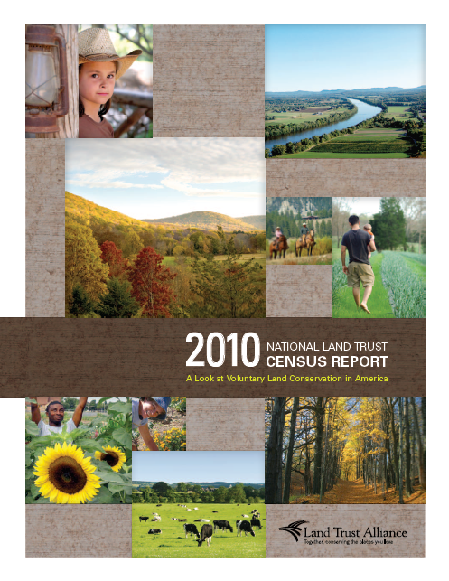
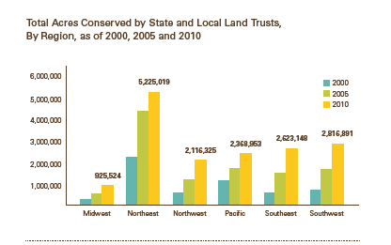
Magnitude of land trust impacts
Over 1700 land trusts (24 national)
Protected 47 million acres

Slide 3
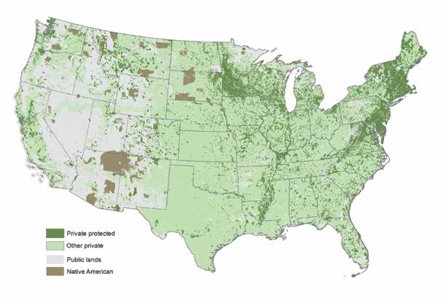
State of the Birds & Land Trusts

Slide 4
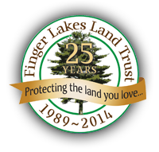
Land Trust Initiative

Slide 5
Phases
1) Discovery phase
2) Regional network interviews
3) Land trust interviews
4) Analysis of mission statements
5) Online survey of land trusts
6) St. Lawrence (NY) region on-the-ground case study
7) WINGS Over Western Waters pilot

Slide 6
Research goals
Understand the current state of bird and habitat conservation by land trusts
Understand what bird conservation information is currently informing land trusts
Explore motivations and barriers for bird and habitat conservation
Consider how to deliver information
Identify other ways to support land trusts

Slide 7
Methods
Interviews to inform survey questions & response options
Online survey
Emailed to US land trusts working at sub-national level
5 email requests in March – April 2014
Incentive: Rally registration drawing
Non-response bias phone survey
614 respondents (response rate: 42%) 144 from Western states (AK, AZ, CA, CO, HI, ID, MT, NV, NM, OR, TX, UT, WA, WY)

Slide 8
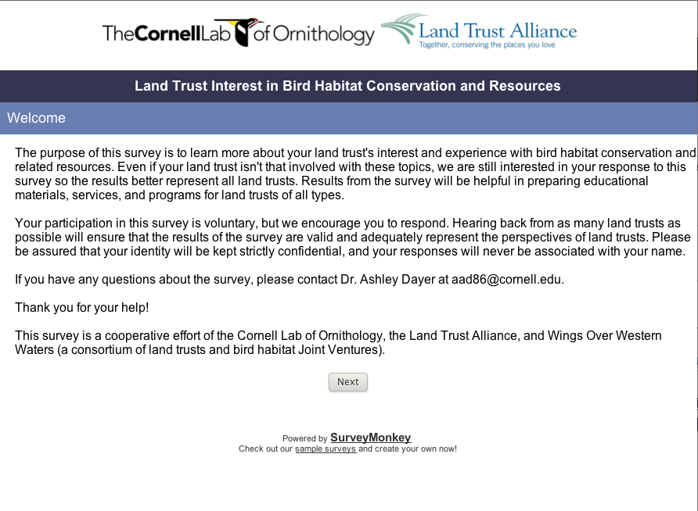

Slide 9
Largely believe they are benefiting birds and habitat
Lesson 1 - Outcomes

Slide 10
More than 50% of Land Benefits
Percentage of Land Trusts

Slide 11
More than 50% of Land with this Habitat
Percentage of Land Trusts

Slide 12
Nearly 1/2 of land trusts put land under easement due to birds Nearly 2/3 considered birds in management plans & prioritized land for conservation for birds (WoW!)
Lesson 2 – Conservation activities

Slide 13
Conservation Activities in Past 5 years
Percentage of Land Trusts
Notes:
Land trusts report contributing to bird conservation --- different than what was seen with mission statements.

Slide 14
Inventory of birds, bird walks, and “other habitat” management most common actions for birds
Lesson 3 – Conservation activities

Slide 15
More specific Activities in past 5 years
Percentage of Land Trusts

Slide 16
Majority believe there is right amount of info, using scientists and conservation plans
Lesson 4 – Use of information

Slide 17
Amount of info?
Too Much | 1.30%
Just right | 45.00%
Too Little | 34.50%
I don't know | 18.40%
Notes:
Do they have enough info to guide this work?

Slide 18
Type of Bird Info used in past 5 years
Percentage of Land Trusts
Notes:
What types?

Slide 19
Greatest barrier is funding, then staff/volunteer capacity (regardless of type of activity)
Lesson 5 – Barriers

Slide 20
Barriers
Percentage of Land Trusts “Agree” or “Strongly Agree”
Notes:
What would get land trusts to do more for birds? Asked them about different types of activities…no difference in response – funding the biggest issue for all; then staff/volunteers.

Slide 21
Greatest motivation is land protection, then funding (but all benefits are motivating)
Lesson 6 – Motivations

Slide 22
Motivations for bird conservation
Percentage of Land Trusts “Agree” or “Strongly Agree”

Slide 23
Place-based info would be beneficial, especially via the web
Lesson 7 – Info needed for more Conservation

Slide 24
Increase conservation with Area-specific info
Percentage of Land Trusts “Agree” or “Strongly Agree”

Slide 25
How receive info
Percentage of Land Trusts “Agree” or “Strongly Agree”

Slide 26
Funds would best ensure land trusts conserve more bird habitat, followed by monitoring support
Lesson 8 – Resources needed for more Conservation

Slide 27
Increase conservation with resources
Percentage of Land Trusts “Agree” or “Strongly Agree”

Slide 28
Lessons learned
Largely believe they are benefiting birds and habitat
Nearly 1/2 put land under easement for birds; nearly 2/3 considered birds in management plans & prioritized land for conservation for birds
Inventory of birds, bird walks, and “other habitat” management most common actions for birds
Majority believe there is right amount of info, using scientists and conservation plans
Greatest barrier is funding, then staff/volunteer capacity
Greatest motivation is land protection, then funding (but all benefits are motivating)
Place-based info would be beneficial, especially via the web
Funds would best ensure land trusts conserve more bird habitat, followed by monitoring support

Slide 29
recommendations
To engage land trusts in bird conservation:
Many already are! Learn from them and share their stories.
Address need for funding mechanisms.
Is it problematic that information sources typically don’t include bird conservation plans? If so, increase awareness and use of plans.
Address need for volunteers through connecting with eBirders and other bird enthusiasts.
Provide land trusts with service area-based resources, connected to larger landscape.
Follow-up with these 500+ land trusts who are interested in bird conservation.

Slide 30
Next steps
Web Resource (with Associated Outreach)
A Land Trust’s Road Map to Bird Conservation Resources
~ Describe, Explain why/how/when land trust uses, Give example, Link~
Bird conservation plans
Important Bird Areas
eBird
All About Birds
Joint Ventures
North American Birds Online
International Migratory Bird Day

Slide 31
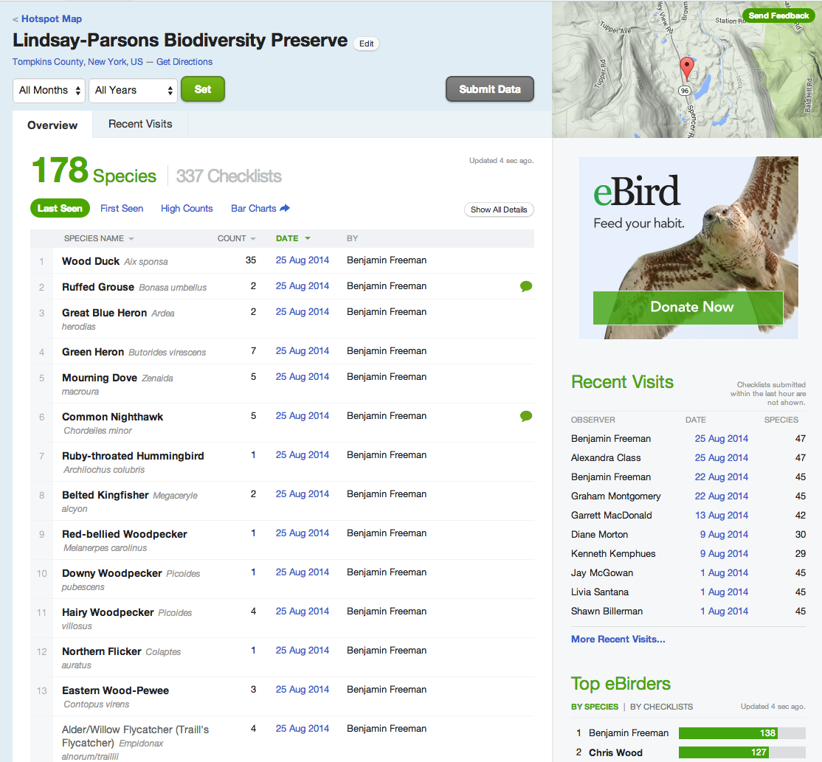
Next steps
eBird and Land Trusts
Birdwatchers = Citizen Science = Benefits for Land Trusts
Selection of land for protection
Data for grant proposals
Justification of easements
Repository for inventory and monitoring efforts
Connection to citizen scientists → monitoring volunteers → supporters → donors?

Slide 32
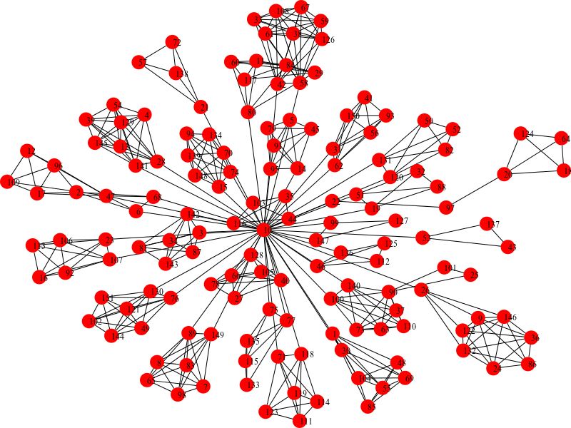
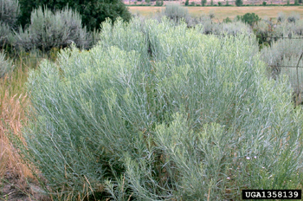
Next steps
Land Trust Networks for Bird Conservation
~ Identify and map clusters~
Ranges of SOTB Watchlist Species
Private Land
Locations of Land Trusts
Sage Obligates in the West
GWWA in Northern NY
Clusters → Networks for Bird Conservation

Slide 33
Next steps
Land Trust Clusters for Bird Conservation
Mechanisms
Species specific conservation package & high-level guidance
Come together for skills & relationship-building workshop
Connect with state agency, local/regional bird conservation experts, & partner biologists
Connect with local/regional eBirding community
Write a collaborative grant proposal for project to address priority species
Benefits
Build relationships between land trusts in a region
Build capacity for conservation planning, fundraising, monitoring
Site-specific support and technical assistance
More priority bird conservation on private lands!

Slide 34
Suggested citation Dayer, A.A., Cosbar, E., Rodewald, A. & Rohrbaugh, R. (2014). Land trusts and bird conservation: A needs assessment. Western states. Ithaca, NY: Cornell Lab of Ornithology.
Primary author contact information:
Ashley Dayer AAD86@CORNELL.EDU

