Slide 1
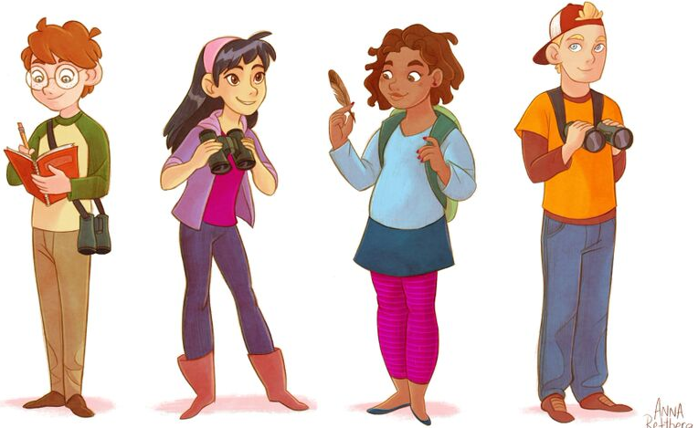

Variables in Science Experiments
What makes an experiment “fair”?
Investigating Evidence
Copyright 2015

Slide 2
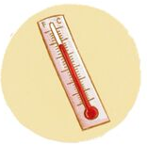
Variables
Variable - something that is changed
Constant (or control) - something that does not change
Notes:
When can temperature be a variable? (Testing if something – like the activity levels of bees - changes when temperatures go up or down.)
When can temperature be a constant? (If we want to know which bird feeder is preferred, we want to keep the temperatures the same during the experiment.)

Slide 3
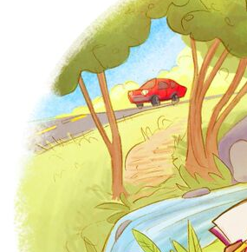
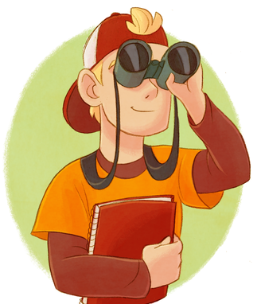
Science experiments use...
Independent Variable
the one factor that is
changed by the person
doing the experiment
Dependent Variable
the factor which
is measured
in the experiment
Constants/Controls
All the factors that stay the same in an experiment
Notes:
To keep an experiment fair, we want to keep a close eye on variables and constants.
You can remember the difference between independent and dependent variables with this trick:
The dependent variable DEPENDS on the independent variable.
Be sure to keep the constants as controlled as possible in your experiments.
In the last picture, what might be going on that could affect your results?
(sounds near the road versus sounds near the stream, shade versus sun, grass versus pavement)

Slide 4
A birdy example...
Imagine you want to see what color of bird feeder your local birds prefer.
Green?
Red?
Blue?
Notes:
If a student wanted to determine whether feeder color has an effect, he might suggest, “if I put up a red, blue, and green feeder, birds will visit the green feeder more” as a hypothesis. He might speculate that the green feeder, being the most “camouflaged” or “natural” might be visited the most.
Let’s take a look at a more specific example:
If a student wanted to determine whether feeder color has an effect, he might suggest, “If I put up red, blue, and green feeders, birds will visit the green feeder more” as a hypothesis. He might speculate that the green feeder, being the most “camouflaged” or “natural,” might be visited the most.

Slide 5
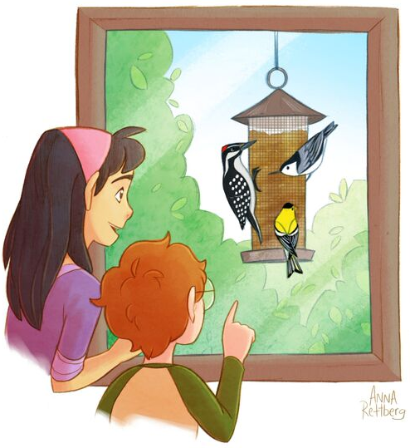
Our Constants and Variables
Independent Variable
- color of the feeders
Dependent Variable
- amount of seed eaten
Constants - everything else that is kept the same Location of feeders
          Kind of feeder used Putting feeders out at the same time
Notes:
Independent Variable: the one factor that is changed by the person doing the experiment
Dependent Variable: the factor which is measured in the experiment
Constants: all the factors that stay the same in an experiment

Slide 6
Our Experimental Design
CONSTANTS | Location of feeders Kind of seed Type of feeder
INDEPENDENT VARIABLE | Red | Blue | Green
DEPENDENT VARIABLE | Amount of Seed Eaten | Amount of Seed Eaten | Amount of Seed Eaten
Notes:
This chart shows the variables and constants within our birdy example.
We keep the constants the same for all three colors of feeders.
The only thing we are changing is the color of feeder. So color of feeder is our independent variable.
The amount of seed eaten will be measured and is called our dependent variable.

Slide 7
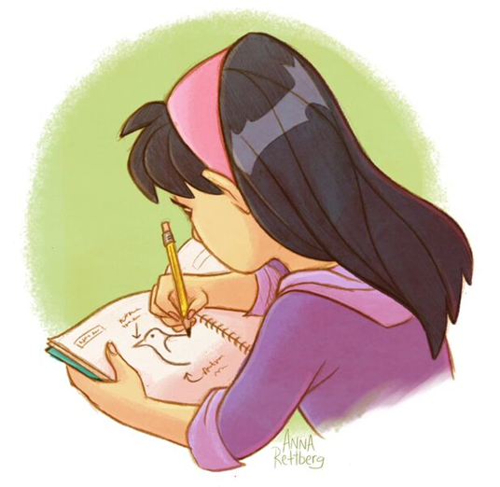
The experiment is FAIR.
If everything except the independent variable is held constant, we can say...
REMEMBER:
Only the independent variable
can change!
Notes:
In our example, only the color of feeder can change.
A FAIR experiment means the information gathered is reliable.

Slide 8
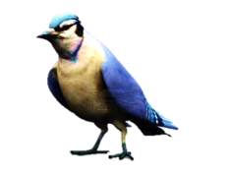
Why is it important to change only the independent variable
?
?
?
Notes:
Collect answers…
You can re-phrase the question and/or ask additional questions:
What might happen if we change more than the independent variable?
Will our results be accurate if we hang some feeders in the sun and others in the shade?
What if we hang them from the same tree branch, but on different days?

Slide 9
If you don't...
If you measure a change in the dependent variable, you won't know whether it is the independent variable that is causing the change.
Independent
Variable
Notes:
Give an example: A girl wanted to know whether her dog scared birds away when it was in the backyard. She thought it would, because the dog likes to bark a lot and has been known to chase little animals.
For 5 days when the dog was out, she counted for an hour.
For 5 days the dog wasn’t out, she counted for an hour.
After she collected the data, she noticed that birds are actually out MORE when the dog is in the yard. Does that surprise you?
But, what the girl didn’t think of was other things that might effect the number of birds that were out. She began thinking that maybe something else might be going on. She realized that the dog was out on sunny warm days, and not on rainy, cool days.
So, even though she found a change, how would she know if it was the dog that caused an effect? Or was it the weather?
See if students can suggest improvements to the experiment, (i.e. making sure the weather and temperature are similar on the days she counts).

Slide 10

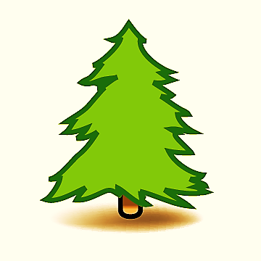

Is Sam's experiment fair?
YES or NO
No!
It isn’t fair since the locations of the
feeders were very different.
Notes:
Read the following scenario to the students:
Sam wants to know if birds prefer one color of feeder to another. He takes three feeders and paints one red, one blue, and one green. He fills the feeders with the same amount of sunflower seed, and plans to keep the feeders out for one week before measuring how much seed is eaten out of each. On Tuesday, he puts each of the feeders in his back yard: the red feeder in a pine tree, the green feeder on a metal pole in the center of the yard, and the blue one in a small bushy tree.
Is Sam’s experiment fair?

Slide 11
Is Maria's experiment fair?
YES or NO
YES!
It seems fair since Maria only changed
the feeder color.
Notes:
Read the following scenario to the students:
Maria wants to know if birds prefer one color of feeder to another. She makes three feeders out of 2-liter bottles and paints one red, one blue, and one green. She fills each of the feeders with the same amount of mixed birdseed, and plans to keep the feeders out for 10 days before measuring how much seed is eaten from each feeder. She puts each of the feeders in the school courtyard in a small tree, hanging each at the same height.
Does Maria’s experiment seem fair?
Read the following scenario to the students:
Maria wants to know if birds prefer one color of feeder to another. She makes three feeders out of wood and paints one red, one blue, and one green. She fills each of the feeders with the same amount of mixed birdseed, and plans to keep the feeders out for 10 days before measuring how much seed is eaten from each feeder. She puts each of the feeders in the school courtyard in a small tree, hanging each at the same height.
Does Maria’s experiment seem fair?

Slide 12
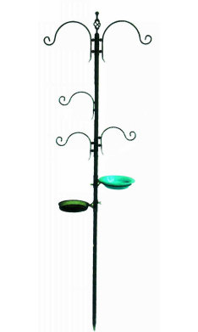
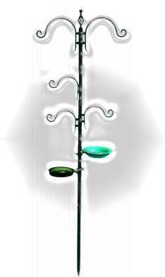
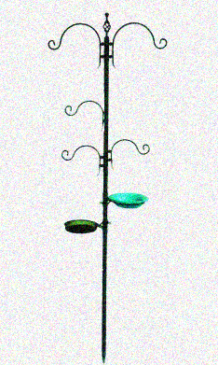
Is Jessie's experiment fair?
YES or NO
NO!
It isn't fair since the feeders are not out at the same time and the weather is different.
Notes:
Read the following scenario to the students:
Jessie wants to know if birds prefer one color of feeder to another. She makes three feeders out of 2-liter bottles and paints one red, one blue, and one green. She fills the each of the feeders with sunflower seed. She plans to leave each feeder out for 2 days and then measure the amount of seed that the birds ate. She has one hook in her backyard the she plans to hang each of the feeders on. She puts the red feeder out on Tuesday and measures the seed 2 days later, the green feeder doesn’t go out until Saturday since it was very snowy, but she is able to measure the seed 2 days later. The weather turned rainy, but she needs to finish her experiment, so blue feeder goes out on Monday and is measured 2 days later.
Is Jessie’s experiment fair?
Read the following scenario to the students:
Jessie wants to know if birds prefer one color of feeder to another. She buys three feeders and paints one red, one blue, and one green. She fills each of the feeders with sunflower seed. She plans to leave each feeder out for 2 days and then measure the amount of seed that the birds have eaten. She has one hook in her backyard that she plans to hang each of the feeders on. She puts the red feeder out on Tuesday and measures the seed 2 days later. The green feeder doesn’t go out until Saturday since it was very snowy, but she is able to measure the seed 2 days later. The weather turned rainy, but she needs to finish her experiment, so the blue feeder goes out on Monday and is measured 2 days later.
Is Jessie’s experiment fair?

Slide 13
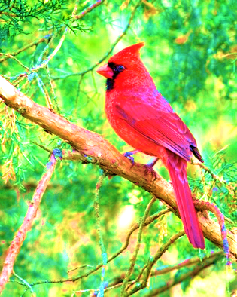
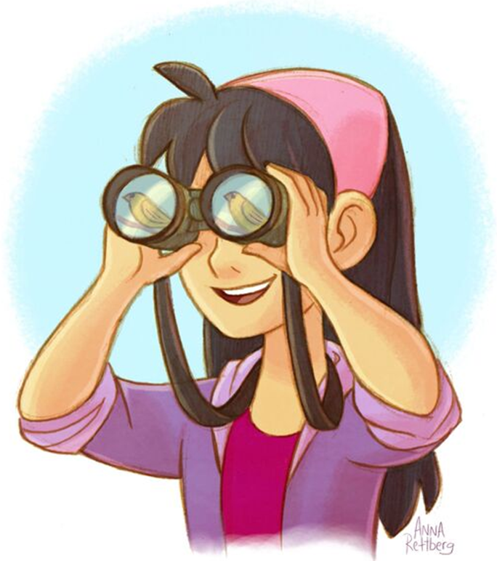
What do you think?
Terry loves birds and wants to see as many as she can in her yard. She wants to know whether she is wasting money buying an expensive mixed seed.
She wonders... Will the expensive seed
attract more birds to her back yard?
How would you to advise her to find
out if the expensive seed is better?
Notes:
You may want to have students brainstorm in pairs, or conduct a group discussion.
You may want to have students brainstorm in pairs, or conduct a group discussion.
Cardinal photo by Stephen A. Wolfe - http://www.flickr.com/photos/swolfe/5735497644/sizes/l/in/photolist-9JPVCq-dTwMsc-7Vufev-7UNxWk-9asjMx-av6GTH-aQqX7i-7Stkjs-7CUAaL-dVhe9K-7DyKTZ-9tSVwX-deXHix-7CQL16-7CQMbT-7CQKNr-7CQKAi-e9MDxp-bBL8XL-dPK8on-daY18E-7DyLbk-dPK8Mr-8z5Bf3-cmcFnh-ehUkGc-ed8AZC-eJHY6a-dRYnho-d2qKjq-88NAyv-88RR9Y-88RPrq-88RQzs-8vNw6i-8vNvTr-dTbEXB-7CUyMh-7CUzR9-885U3H-bhoFVn-bqv89i-cv9S5w-8JdDLd-8JKuVv-7yJmWh-ayydDD-8JKuMv-dE2kq4-axXNh5-bQXYL4/
Hummingbird photo by Eric Kilby - http://www.flickr.com/photos/ekilby/7491131538/sizes/m/in/photolist-cpY1qj-ctd9Ew-82Zy7D-ae7MMa-eifP9Z-ae7MQ8-ev8tHp-8zkha5-cGQ9Eh-9yLLeW-82Zxfe-8HofWU-eaN8jt-eaN8dD-eaTWY3-fhSEVs-fhCpxa-fhSERJ-fhSEU7-aaNzKG-aaKHt4-aaNxLj-ebToPk-ebZXL6-dbZYCW-dbZYoR-dbZYBZ-8AFhSP-cPZq2u-cPZq6G-eJNSkV-bW9QHw-7BJHzE-am6HbW-eY2nfc-8q3i27/

Slide 14
Terry's Experimental Design
Independent Variable | ?
Dependent Variable | ?
Constants | ?
Notes:
14
What is the Independent Variable?
What is the Dependent Variable?
What would you hold constant?
Ask students:
What is the independent variable?
What is the dependent variable?
What would you hold constant?

Slide 15
Terry's Experimental Design
Independent Variable | Kind of seed: Expensive or Cheap
Dependent Variable | Number (and perhaps kinds) of birds that visit
Constants | Location of feeders Type of feeder How seed is measured How birds are counted
Notes:
15
What is the Independent Variable?
What is the Dependent Variable? Number of birds– also, you may want to record what KINDS visit. Maybe diversity is higher with one seed or the other!
What would you hold constant? There are other answers as well. Feel free to add to the list
What is the independent variable? Expensive or cheap seed
What is the dependent variable? Number of birds– also, you may want to record what KINDS visit. Maybe diversity is higher with one seed or the other!
What would you hold constant? There are other answers as well. Feel free to add to the list.

Slide 16
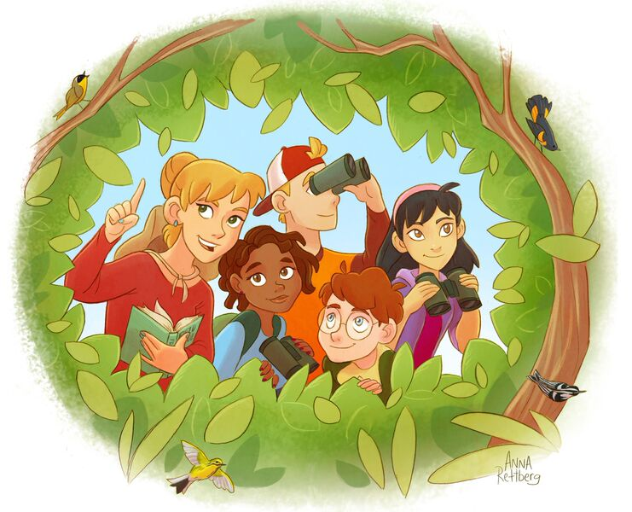
What experiments are you planning?
What are your variables?
How will you keep your experiment fair?

Slide 17
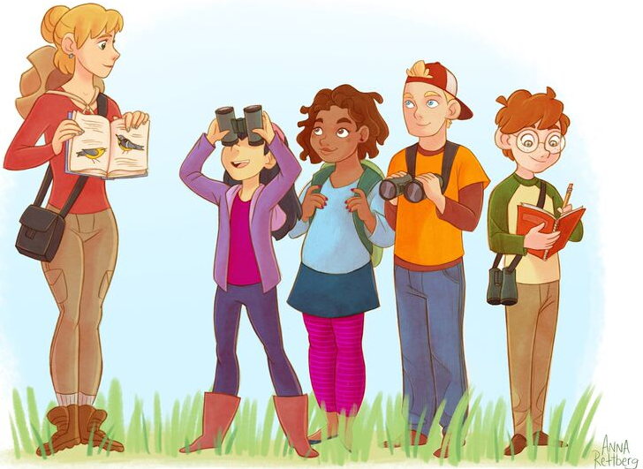
Keep in Touch!
Twitter: @birdsleuth
Facebook: BirdSleuth
Website: www.birdsleuth.org
Email: jms327@cornell.edu (Jennifer Fee)
Photo courtesy of Ian Davies

