Slide 1

Grasping Graphing
Solutions to Understanding
and Presenting Data
Understanding
and Presenting Data

Slide 2
Welcome to “Grasping Graphing.” I’m Oscar Grackle, here to talk to you about graphing. Graphs help you understand and display data.
Oscar Grackle

Slide 3
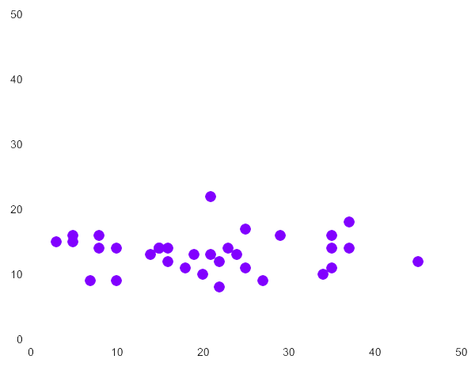
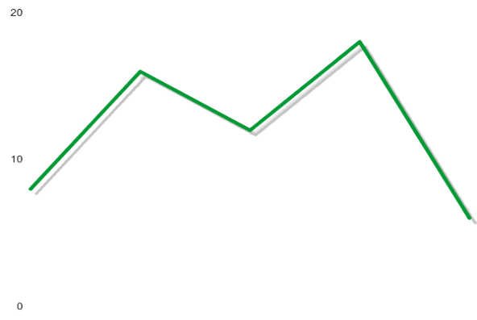
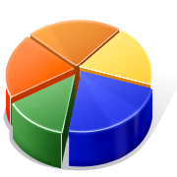
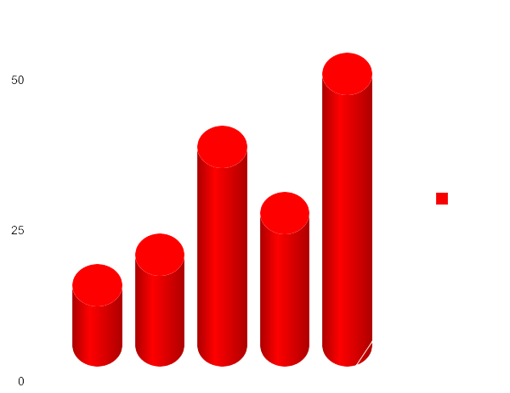
We’ll discuss the most commonly used graphs in science:
line graphs
scatter plots
pie graphs
and bar graphs

Slide 4

Today, you will learn how to use these graphs to clearly display your data. You will also learn how to interpret a graph.

Slide 5

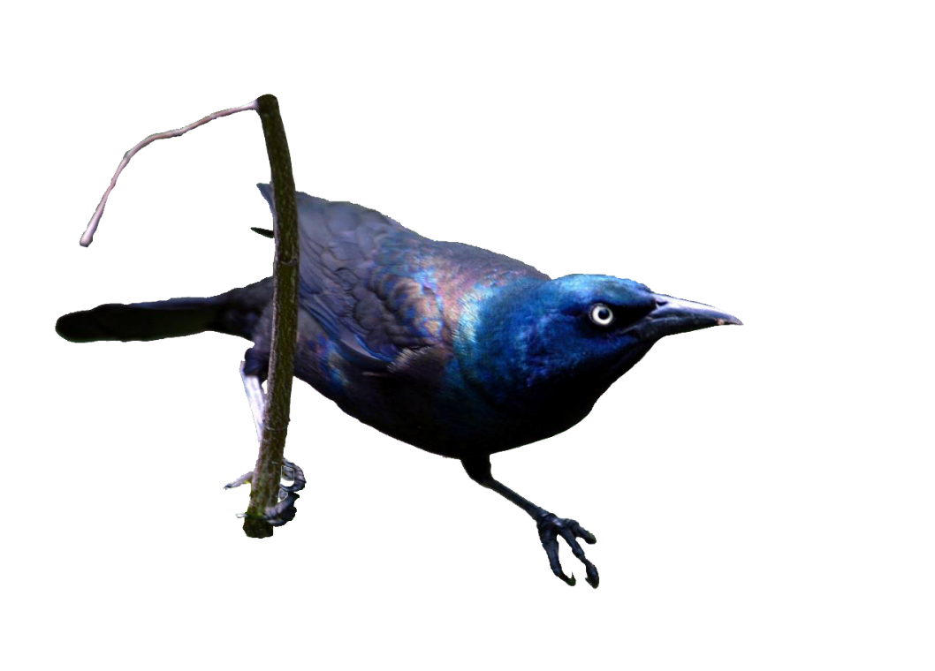
Ralph, I’m busy!
What are you doing?!
Sorry Oscar, but I have a mess on my hands …
I’ve gathered data for a science study, but now I’m confused.

Slide 6

Ok, Ralph, I can help you grasp graphing basics. Then you can help me show these students how to choose the type of graph that best suits your data and your purpose!
Thanks Oscar!

Slide 7
I know a place where we can focus on our work. Let’s get out of here!
Notes:
7

Slide 8

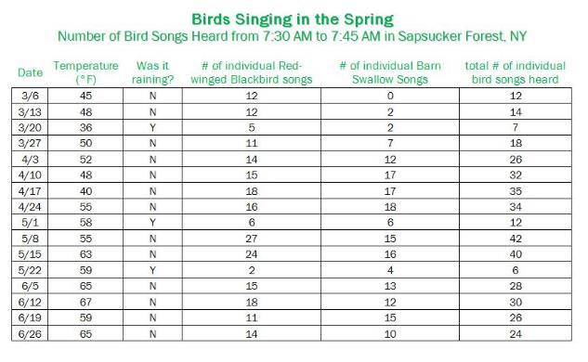
Ok, Ralph, let’s see what your data looks like. This table is a good start.
Before you make any type of graph, you should first organize your information so that you can make sense of it.

Slide 9


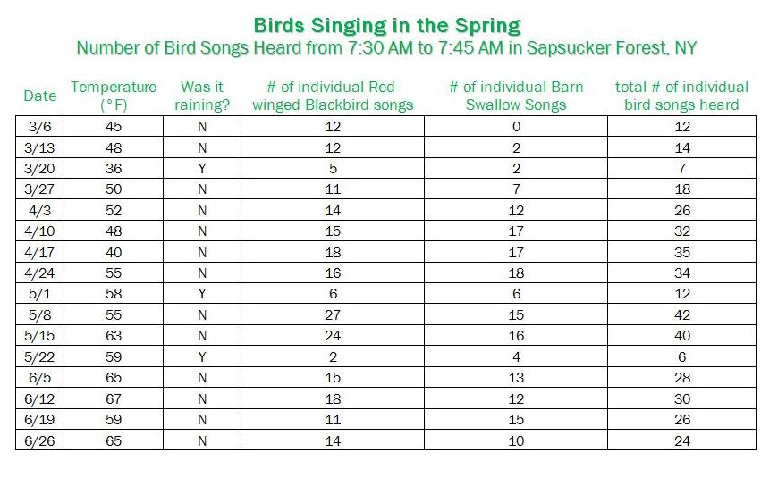

It looks like you were trying to see what types of things affect birds singing.

Slide 10

So, the graphs we want to use are…
I know Oscar, we want a pie chart.
I love pies!

Slide 11

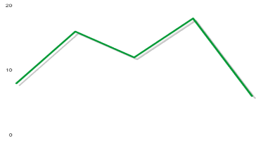
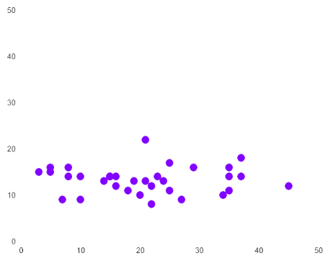
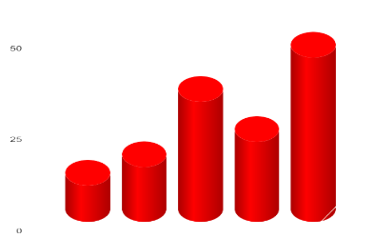

Click on each graph to learn how Ralph can display his data in different ways. Click the arrow at the bottom when you are ready to move on.
line graphs
pie graphs
scatter plots
bar graphs

Slide 12

Pie graphs compare parts of your data. They compare proportions, or percentages, of a whole. Remember, a whole pie is 100% of a pie!
To make a pie graph, you need to organize your data into categories and calculate the percentage of each category.
Lets talk about Pie Graphs.
Mmm, I love pies!

Slide 13
Brainstorm some categories that Ralph could compare using his data.
When you’re done, I’ll show you the pie graph that Ralph and I made.

Slide 14


That sounds like a job for a pie graph!
I remember the birds sang more in April. I’d like to show how many bird songs I heard in March versus how many I heard in April.
Bird songs in March and April
Click here to learn how to make a pie graph

Slide 15
Reorganize your data to show what is relevant to your question.
In this case, we will focus on the data showing us the individual songs in March and April.

Slide 16
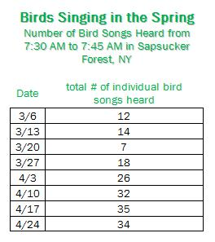
2. Create fractions for each category.
First, find the numerators.
(In a fraction, the numerator is the number on top of the fraction bar.)
Our numerators are
51 and 127.
Numerators
March
12 + 14 + 7 +18 = 51
April
26 + 32 + 35 + 34 = 127

Slide 17
3. Next, add all your numerators to get the denominator.
In this case, our denominator is going to be the total number of individual songs during March and April.
51+127 = 178
Our final fractions are
March: 51/178
April: 127/178
Numerators
March
12 + 14 + 7 +18 = 51
April
26 + 32 + 35 + 34 = 127
178
denominator
178
denominator

Slide 18
4. We’re almost there! Now convert fractions to a decimal:
Divide your numerator by your denominator.
51
178
= March
127
178
= April
Read fractions from top to bottom, like this:
51 divided by 178
or 178 51

Slide 19
March
51
178
= 0.29 or 29%
So for March we divided 51 by 178 to get 0.286516 or 0.29.
April is 127 ÷ 178 = .713483, which is rounded to .71.
(Change decimals to percentages by moving the decimal point 2 places to the right.)
April
127
178
= 0.71 or 71%
100%
Hey Oscar, the percentages add up to 100, just like you said!

Slide 20
5. How big should the pieces of your pie graph be?
Multiply the decimals by 360 (degrees in a circle) to find the angle for each category.
March = 29% of the pie = 104.4º
April = 71% of the pie = 255.6º
Your degrees will add up to 360 – a full circle!
^{104.4 + 255.6 = 360}
March
0.29
x 360 =
104.4°
April
0.71
x 360 =
255.6°
360 °

Slide 21

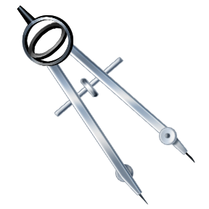
6. Draw a circle.
Use a mathematical compass to draw a circle.
If you don't have a compass, try tracing something round such as a lid or a CD.
Creating a dot with the compass makes it easier to find the center in the next step.
.

Slide 22
7. Draw a radius.
Start in the exact center and draw a radius to the edge of the circle.
The dot we made with the compass is the center, so we just need to draw a line from the dot to the edge.
.

Slide 23
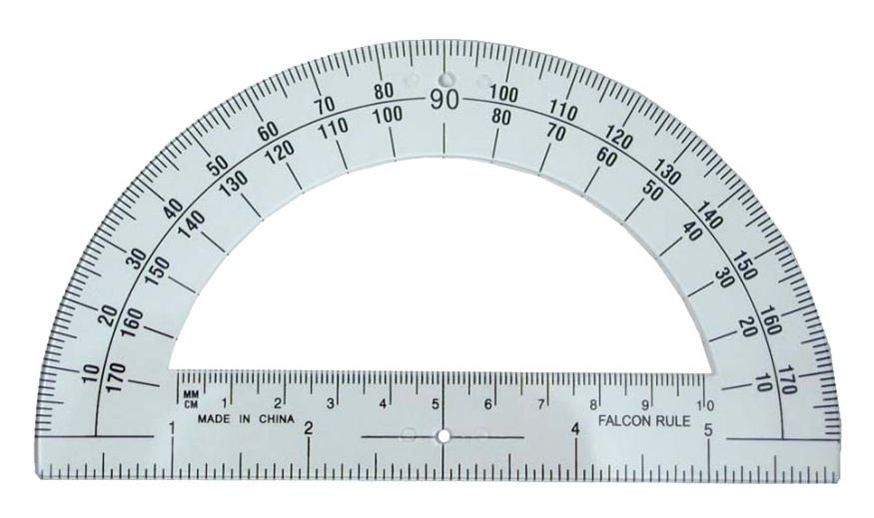
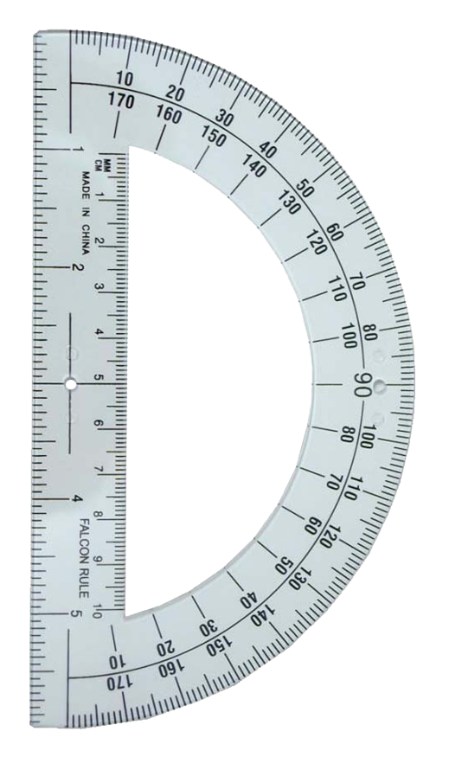
8. Draw each section.
Draw the sections by using the angles you calculated in step five. Each time you add a section, the radius changes to the line you just drew.
Our March section extends 104.4°from the radius.
Our April section extends 255.6°from the radius.
March
104.4°
April
255.6°

Slide 24
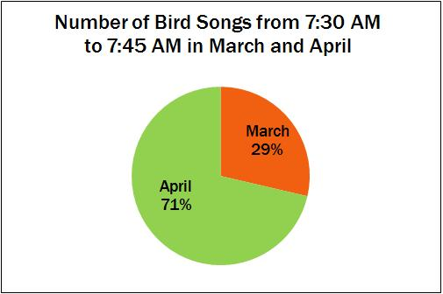
9. Title and label your graph.
Add the name of the sections and the percent they represent.
Color each section of the pie graph differently.
You’ve just made a pie graph! Now it’s easy to see when more birds are singing!

Slide 25
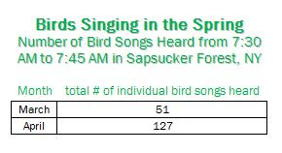
Here are the reorganized data table and pie graph that Ralph and I made.
Wow! Now I can see that almost ¾ of the songs I heard were in April!

Slide 26
Exactly, Ralph! When you compare groups of data using pie graphs, you can see how much more one category has than another. When you calculate percentages and write them onto a graph, you can use real numbers to compare categories, instead of just guessing.

Slide 27
Use the categories you brainstormed earlier or the ones below to create your own pie graph. Make sure you know which total group they fall into!
If you need help, here are some categories:
Number of bird songs when it rained vs. number of songs when it didn’t rain
How many days it rained in March vs. April vs. May
Number of days in April that the temperature was above 50°F vs below 50°F
Back to the Graph Menu

Slide 28

Line graphs show how something changes over time, temperature, or anything else that changes in consistent increments.
Let’s say Ralph wants to show how the amount of Barn Swallow songs change over time. First reorganize the data table to show only Barn Swallow data and the dates when Ralph collected that data. Then make the graph.
Click here to learn how to make a line graph

Slide 29
Reorganize your data to separate what is relevant.
In this case, we will focus on the data showing the number of individual Barn Swallow songs from March to June.

Slide 30
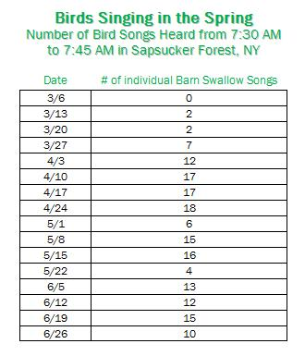
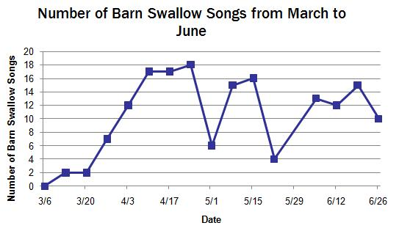

2. Begin a line graph by
drawing a plot.
The horizontal line is the x axis. The vertical line is the y axis.

Slide 31
3. Label your axes.
Write “Date” on the x-axis and draw a scale that includes every day of the investigation.
We can use time because Ralph controlled the day. He collected data every 7 days during his study.

Slide 32
3. Label your axes.
Write “Number of Barn Swallow Songs” on the vertical axis and draw a scale that includes the lowest and highest number of bird songs.
Make sure your scale is consistent. In this case, we counted by 2s.

Slide 33

Our graph would look like this!
Oscar, do you HAVE to put time on the horizontal axis and the number of songs on the vertical axis?
What happens if you switch them?
It still shows the same data. However, scientists and mathematicians usually place time, temperature, and other things that change on the horizontal axis, so we will, too!

Slide 34

Here are the reorganized data table and line graph.
Now we can see that Barn Swallow songs increased a lot more from March to April! Why do you think that might be?

Slide 35
Scientists use line graphs to see how things change over time. They also use line graphs to find unusual data.
For example, if we only looked at our data table instead of graphing it, we probably would not have seen these sharp valleys. What do you think happened here?

Slide 36
I remember that I got completely soaked in the rain those two days! Maybe I heard fewer songs because it was raining.

Slide 37
What other line graphs can Ralph make with his data? Try making one on your own! Click below for some ideas or brainstorm some of your own.
Click here for line graph ideas
Back to the Graph Menu

Slide 38
Here are some line graph ideas:
The change in temperature vs. time
The change in the total number of bird songs vs. time
When it rained or didn’t rain vs. time (this one is a challenge!)

Slide 39
You can use any two variables on a scatter plot, but it is easier if they have numerical values. Let’s use temperature and number of bird songs, because we can use numbers to describe them.

Slide 40
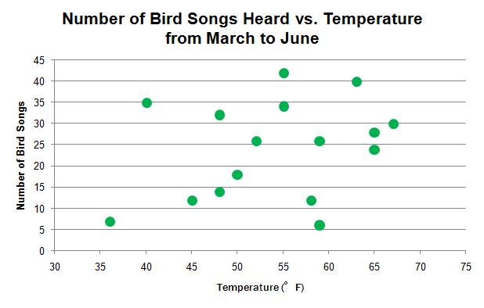
When we plot temperature vs. number of bird songs, we get this plot! What does this plot tell about how temperature and bird songs are related?
The graph shows that, in general, I heard more songs on hotter days. Apparently it’s hard to sing when it’s chilly!

Slide 41
We can say that, in general, Ralph heard more songs when the temperature was higher. Our data follows a trend.
There are a couple of points that don’t fit our trend. They are called outliers.

Slide 42
In a scatter plot, you don’t connect the points with a line because you’re only looking for patterns. Line graphs, however, always connect data points, showing changes over time.
What's the difference between a line graph and a scatter plot? You’re plotting points for both!

Slide 43
In the graph on the left, we used the same data as we did in the scatter plot. We also connected the data points in the order that they were collected.
How are these two graphs different?
Which one helps you understand the data Ralph collected?
Spend a couple of minutes brainstorming answers to these questions.
Back to the Graph Menu

Slide 44
Bar graphs, like pie charts, can be used to compare different categories. But you don’t need to use percentages. Ralph, what categories do you want to compare?
How about bird songs when it is raining and bird songs when it isn't raining? We haven’t done that one yet.
Click here to learn how to make a bar graph

Slide 45
Reorganize your data to separate what is relevant.
In this case, we will focus on the data showing the days it rained from March to June and the number of bird songs heard.

Slide 46
2. Put the different categories on the horizontal axis.
We will call our two categories “Raining” and “Not Raining.”
3. Put “Average Number of Bird Songs Heard” on the y axis and draw a scale.
Birds Singing in the Spring
Number of Bird Songs Heard from 7:30AM to 7:45AM in Sapsucker Forest, NY
 | Total # Bird Songs Heard | # Days | Average Bird Songs Heard per Day
Raining | 25 | 3 | 8.3
Not raining | 361 | 13 | 27.8

Slide 47
4. Draw a line and fill in the bar.
Birds Singing in the Spring
Number of Bird Songs Heard from 7:30AM to 7:45AM in Sapsucker Forest, NY
 | Total # Bird Songs Heard | # Days | Average Bird Songs Heard per Day
Raining | 25 | 3 | 8.3
Not raining | 361 | 13 | 27.8

Slide 48

You can also split the categories into subcategories, to make even more comparisons. Let’s split each category by month.
What extra information does the new chart give? Is one chart better than the other?
When would you use each?
Spend a couple of minutes brainstorming answers to these questions.

Slide 49

That’s right! Here is a pie graph I made using the same data.
Hey Oscar, I just realized that our bar graph is like our pie graph – they both separate data into categories!

Slide 50
Do the pie graph and bar graph give us different information? If so, what? If not, why not?
Is one graph better than the other? When would you use each?
Spend a couple of minutes brainstorming answers to these questions.
Back to the Graph Menu

Slide 51
Drawing graphs allows us to show relationships, or the connection between two things. Ralph’s graphs show the relationship between number of bird songs and rain, temperature, or day. Do you remember why Ralph collected this data?
Yeah, because I wanted to know what kinds of things affect bird songs.

Slide 52
Right! Our graphs show us that fewer birds sing when it rains than when it doesn’t rain, and that fewer birds sing when it is colder outside. We haven’t proven that fewer birds sing because of rain or cold. But, at least now we know that those factors might affect bird songs.
Scientists use graphs to show relationships and help answer their scientific questions.

Slide 53
Let’s review!
What kind of graph would you create if you wanted to show:
Number of boys vs. girls in your class
How the number of baby birds in your backyard changes from April to June
The relationship between height and weight of the people in your family
The favorite subjects of students in your grade vs. your class
The population of the entire world by continent
How much you have grown from last year to this year
Click here for the answers

Slide 54
Answers
Number of boys vs. girls in your class: Pie graph or bar chart
How the number of baby birds in your backyard changes from April to June: line graph
The relationship between height and weight of the people in your family: scatter plot
The favorite subjects of students in your grade vs. your class: bar chart
The population of the entire world by continent: pie chart
How much you have grown from last year to this year: line graph

Slide 55
Reflection Questions
Are graphs useful? Why or why not?
What do you like about graphing? What do you dislike?
Why do scientists use graphs? Why would you use graphs?

Slide 56
Grasping Graphing
Understanding
and Presenting Data
Thank you for your participation!
- end of course -

