Slide 1
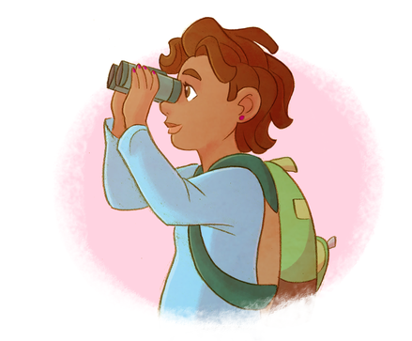

Hypothesis Help

Slide 2
Hypothesis Help – Part 1
Crafting
Hypotheses

Slide 3
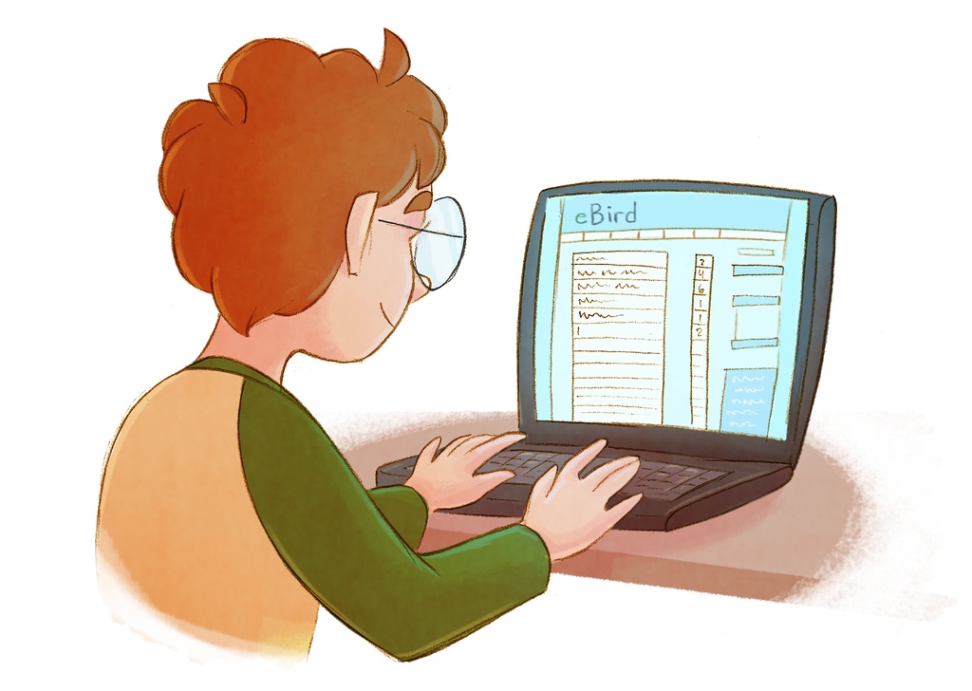
Hypothesis
“A testable statement about the natural world which can be supported or rejected by experiments or observations”
?
How do we turn a QUESTION
into a HYPOTHESIS ?

Slide 4
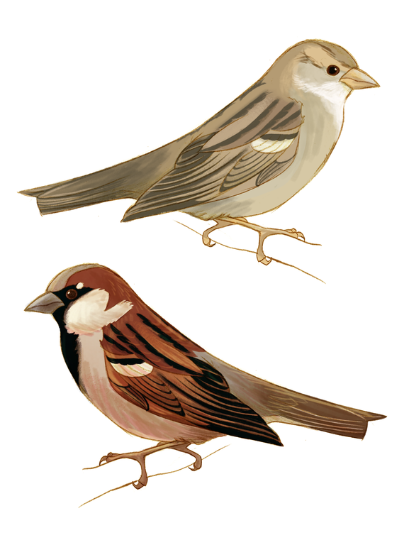
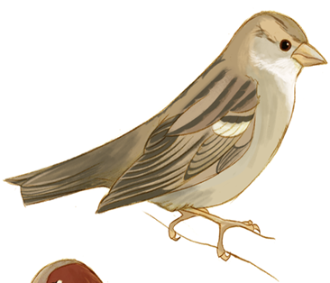
What do I wonder?
Suppose you are curious where birds prefer to eat - out in the open or in more sheltered places….

Slide 5
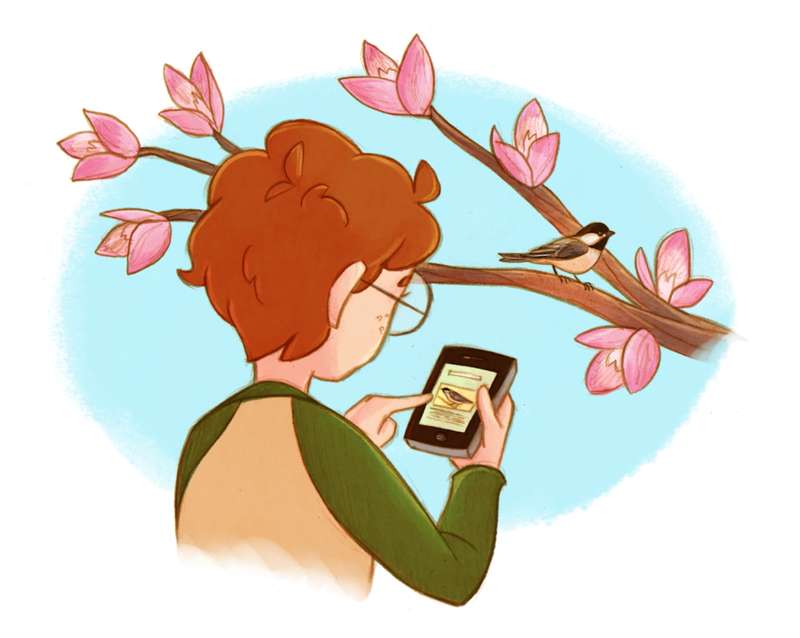
What do I already know?
Before you turn your question into a hypothesis, you need some background knowledge about this topic.
You do some research
and discover…
Cats can jump 10 to 15 feet.
Cats are the main
predators of urban birds.

Slide 6
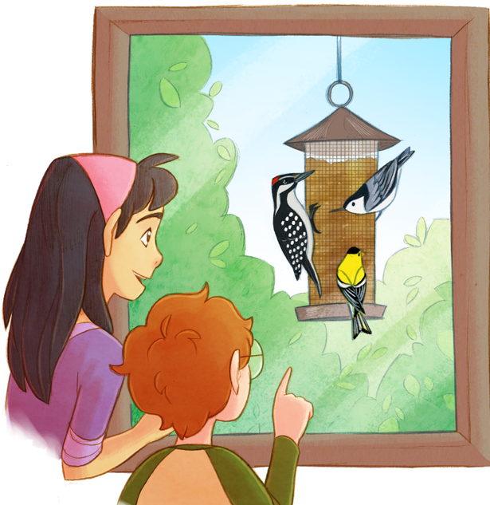
How do I turn my idea into a hypothesis?
This information might lead you to think that birds prefer eating out in the open because they will feel safer. Your stated hypothesis could be…
“If feeders are placed at least 15 feet
from vegetative cover,
then more birds will visit those feeders.”

Slide 7





How do I test my hypothesis?
To test this hypothesis you might design this study:
  Watch two identical bird feeders with the same seed:
  Record the number of birds that visit during specified time intervals during the day.
Hang one 15 feet from vegetative cover (hedges, a tree, etc.).
Hang the other 3 feet from the same vegetative cover.

Slide 8
Hypothesis Help – Part 2
Graphing

Slide 9
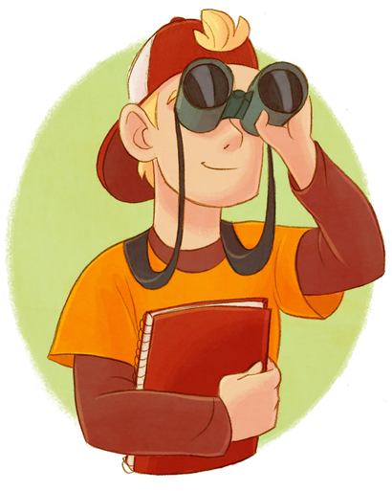
How do I know if my hypothesis was supported?
The data you collect can be used as evidence to either support or reject your hypothesis.
Do birds visit the unsheltered
feeders more often, as you
expected? If so, the data
supports your stated
hypothesis.

Slide 10
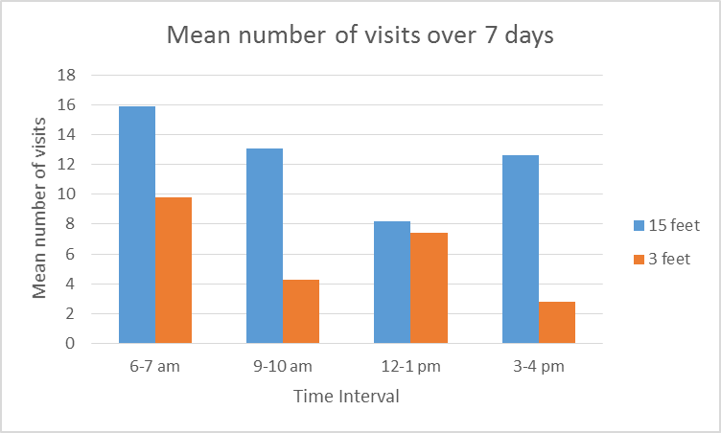
Graph 1: Hypothesis supported
Notes:
The mean number of visits seems highest for the feeders placed 15 feet from vegetative cover.

Slide 11
What if I didn’t find any differences?
If your results show that birds visit the two feeders about the same, you would conclude that feeder location has no effect on feeding rates.
        We call this a null hypothesis, which means you could not find a pattern or relationship for the things you were testing. You would therefore reject your stated hypothesis and support your null hypothesis.

Slide 12
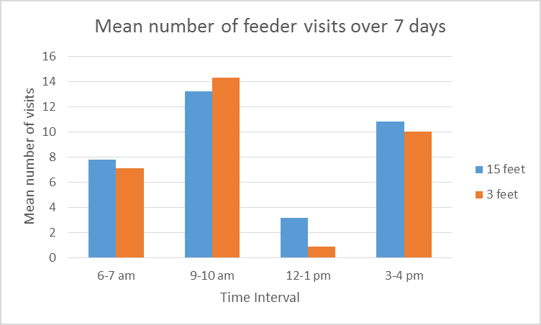
Graph 2: Null Hypothesis Supported
Notes:
The mean number of visits would be about the same for both 15 and 3 foot locations.

Slide 13
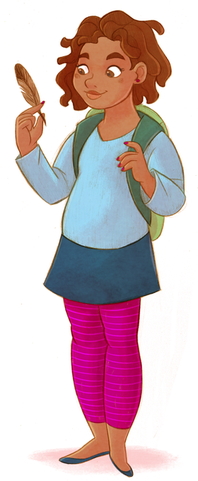
What if I found something other than what I expected?
Finally, it may be that the opposite is true.
Your results could show that more birds visit sheltered feeders! You might then predict that more birds visit feeders near vegetative cover because they are more concerned about safety from predatory hawks in the sky instead of cats from the ground.

Slide 14
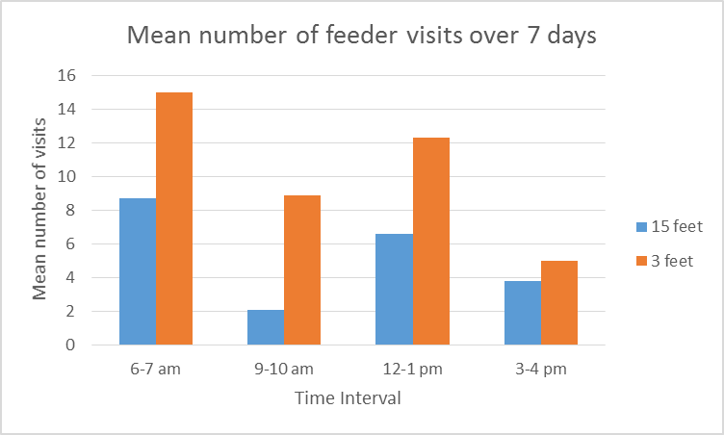
Graph 3: Alternative Hypothesis Supported
Notes:
The mean number of visits are higher for feeders placed 3 feet from vegetative cover.

Slide 15
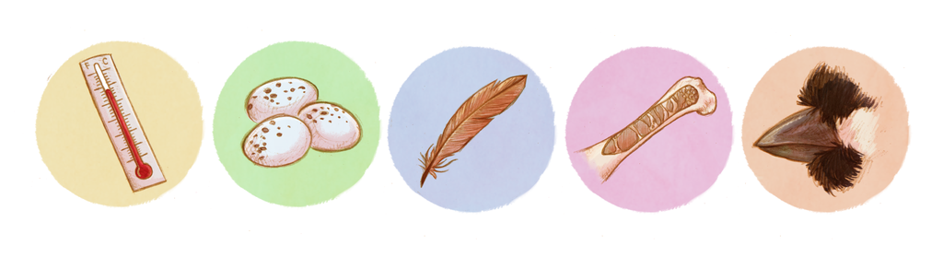
Remember…
Any outcome (whichever hypothesis is supported) is valuable.
Hypotheses and experiments are not about being right or wrong.
They are useful tools for exploring and understanding the natural world.

Slide 16
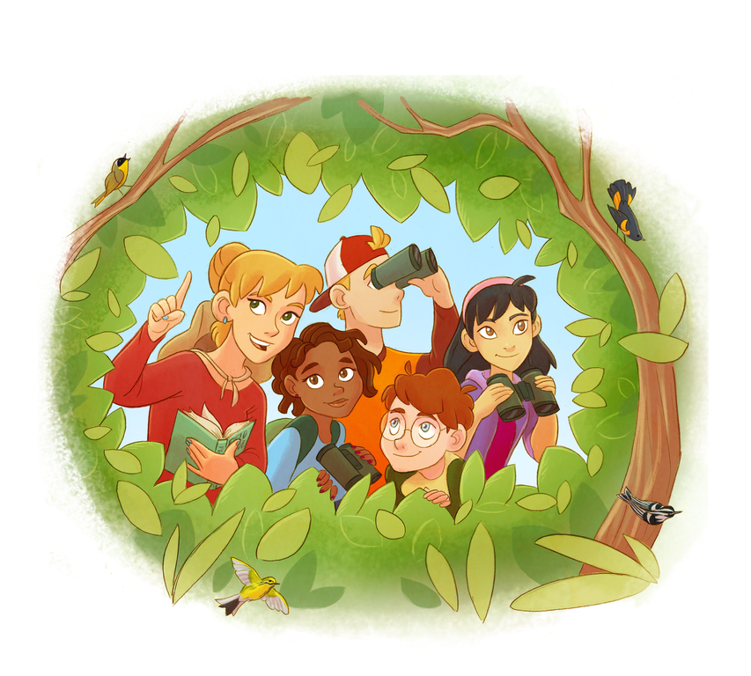
Keep in Touch!
Twitter: @birdsleuth
Facebook: BirdSleuth
Website: www.birds.cornell.edu/k12
Email: jms327@cornell.edu (Jennifer Fee)
Photo courtesy of Ian Davies
Notes:
-You can tweet us at our handle or send us an “old-fashioned” email

