Slide 1

Land Trusts & Bird conservation:
A Needs Assessment
Ashley Dayer, Ph.D.

Slide 2
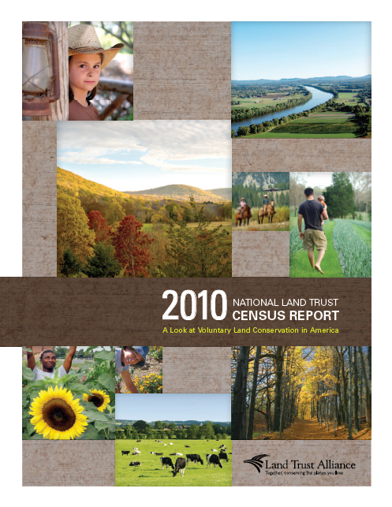
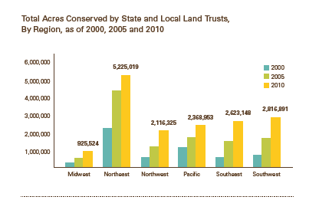
Magnitude of land trust impacts
Over 1700 land trusts (24 national)
Protected 47 million acres

Slide 3
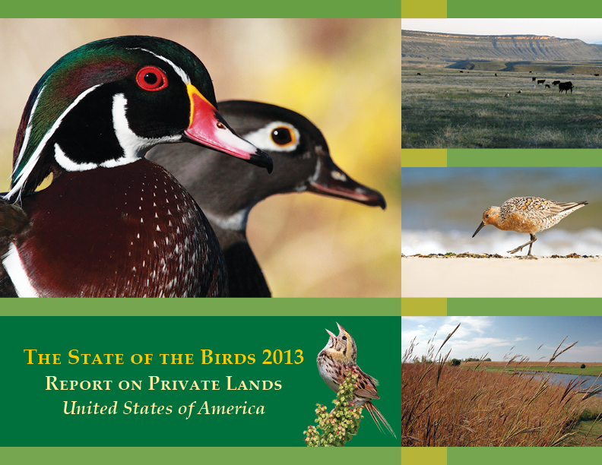
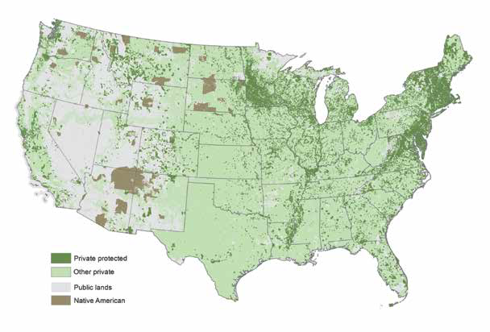
State of the Birds & Land Trusts

Slide 4
Nabci & land trusts
Engage land trusts in bird conservation (Land Trust Alliance as well as regional and national land trusts), educating them on what they can do for birds, resources for them. Use insights from Cornell Lab of Ornithology's survey of land trusts and current examples from AMJV, IWJV, RMBO, others where land trusts are valuable partners.
-NABCI Strategic Plan, 2014

Slide 5


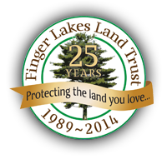


Land Trust Initiative

Slide 6
Phases
1) Discovery phase
2) Regional network interviews
4) Land trust interviews
5) Analysis of mission statements
6) Online survey of land trusts
7) St. Lawrence (NY) region “use-case”
8) WINGS Over Western Waters pilot

Slide 7
Research goals
Understand the current state of bird and habitat conservation by land trusts
Understand what bird conservation information is currently informing land trusts
Explore motivations and barriers for bird and habitat conservation
Consider how to deliver information
Identify other ways to support land trusts

Slide 8
Methods
Interviews to inform survey questions & response options
Online survey
Emailed to US land trusts working at sub-national level
5 email requests in March – April 2014
Incentive: Rally registration drawing
Non-response bias phone survey
614 respondents (response rate: 42%)
Notes:
Kestrel Land Trust (MA)
Central Indiana Land Trust
Minnesota Land Trust
Teton Regional Land Trust (WY)
Tejon Ranch Conservancy (CA)
Columbia Land Trust (OR/WA)
Virginia Eastern Shores Land Trust
North Carolina Coastal Land Trust
Land Trust for Louisiana
Conservation Foundation for the Gulf Coast (FL)

Slide 9
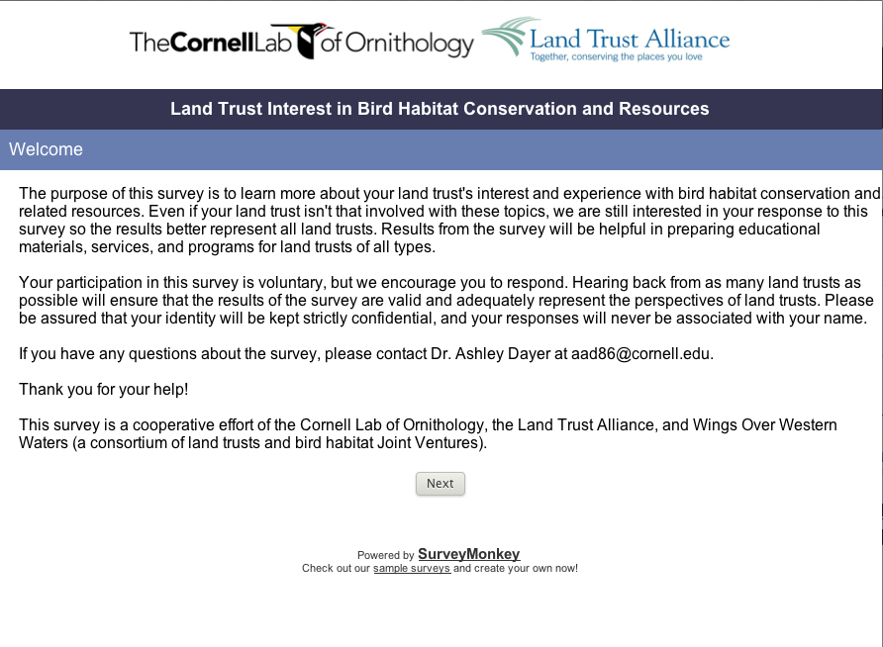

Slide 10
Largely believe they are benefiting birds and habitat (especially forests)
Lesson 1 - Outcomes

Slide 11
More than 50% of Land Benefits
Percentage of Land Trusts

Slide 12
More than 50% of Habitat Benefits
Percentage of Land Trusts

Slide 13
Nearly 1/2 of land trusts put land under easement due to birds
Nearly 2/3 considered birds in management plans
(WoW!)
Lesson 2 – Conservation activities

Slide 14
Conservation Activities in Past 5 years
Percentage of Land Trusts
Notes:
Land trusts report contributing to bird conservation --- different than what was seen with mission statements.

Slide 15
Inventory of birds, bird walks, and invasives management most common actions for birds
Lesson 3 – Conservation activities

Slide 16
More specific Activities in past 5 years
Percentage of Land Trusts

Slide 17
Majority believe there is right amount of info, but not widely using conservation plans, science articles, or eBird
Lesson 4 – Use of information

Slide 18
Amount of info?
Too Much | 1.30%
Just right | 45.00%
Too Little | 34.50%
I don't know | 18.40%
Notes:
Do they have enough info to guide this work?

Slide 19
Type of Bird Info used in past 5 years
Percentage of Land Trusts
Notes:
What types?

Slide 20
Greatest barrier is funding, then staff/volunteer capacity
Lesson 5 – Barriers

Slide 21
Barriers
Percentage of Land Trusts “Agree” or “Strongly Agree”
Notes:
What would get land trusts to do more for birds? Asked them about different types of activities…no difference in response – funding the biggest issue for all; then staff/volunteers.

Slide 22
Greatest motivation is land protection, then funding (but all benefits are motivating)
Lesson 6 – Motivations

Slide 23
Motivations for bird conservation
Percentage of Land Trusts “Agree” or “Strongly Agree”

Slide 24
Place-based info would be beneficial, especially via the web
Lesson 7 – Info needed for more Conservation

Slide 25
Increase conservation with Area-specific info
Percentage of Land Trusts “Agree” or “Strongly Agree”

Slide 26
How receive info
Percentage of Land Trusts “Agree” or “Strongly Agree”

Slide 27
Funds would best ensure land trusts conserve more bird habitat, followed by monitoring support
Lesson 8 – Resources needed for more Conservation

Slide 28
Increase conservation with resources
Percentage of Land Trusts “Agree” or “Strongly Agree”

Slide 29
Lessons learned
Largely believe they are benefiting birds and habitat (especially forests)
Nearly 1/2 put land under easement for birds; nearly 2/3 considered birds in management plans
Inventory of birds, bird walks, and invasives management most common actions for birds
Majority believe there is right amount of info, but not widely using conservation plans, science articles, or eBird
Greatest barrier is funding, then staff/volunteer capacity
Greatest motivation is land protection, then funding (but all benefits are motivating)
Place-based info would be beneficial, especially via the web
Funds would best ensure land trusts conserve more bird habitat, followed by monitoring support

Slide 30
recommendations
To engage land trusts in bird conservation:
Many already are! Learn from them and share their stories. Also learn from Audubon.
Address need for funding mechanisms for upland bird habitat protection.
Is it problematic that information sources typically don’t include bird conservation plans? If so, increase awareness and use of plans.
Address need for volunteers through connecting with eBirders and other bird enthusiasts.
Provide land trusts with service area-based resources, connected to larger landscape.
Follow-up with these 500+ land trusts who are interested.
Notes:
Mention under #2 – Farm Bill programs, state wildlife grants and PFW
Mention under #6 – connect to JV or bird partnerships

Slide 31

Next steps
Web Resource (with Associated Outreach)
A Land Trust’s Road Map to Bird Conservation Resources
~ Describe, Explain why/how/when land trust uses, Give example, Link~
Bird conservation plans
Important Bird Areas
eBird
All About Birds
Joint Ventures
North American Birds Online
International Migratory Bird Day

Slide 32
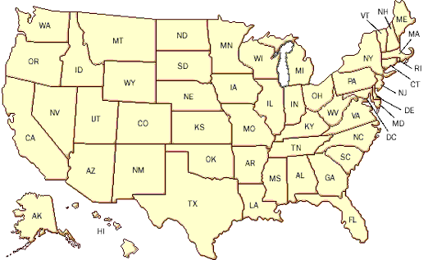
Next steps
Web Resource (with Associated Outreach)
Place-based Resources
What state is your land trust service area located in?
Your bird conservation plans
-Landbirds
-Shorebirds
-Waterbirds
-Waterfowl
- Species?
Your priority species
- State of the Birds watchlist
- State agency SGCN birds
Your bird conservation partners
- Joint Venture contacts
- Other
Your funding sources
- National (NAWCA)
- PFW contact
- NRCS funding resources

Slide 33
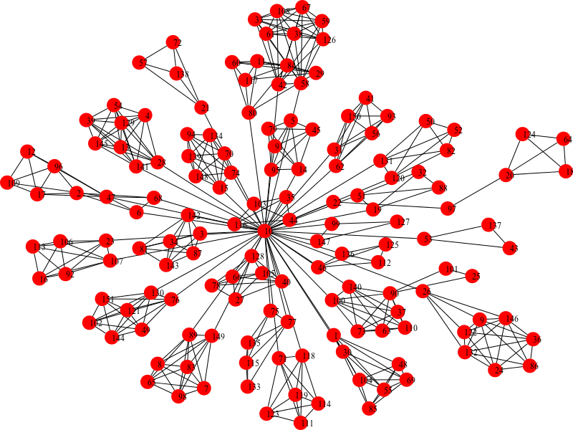
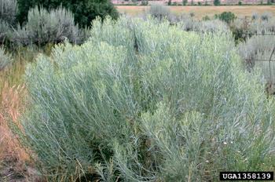

Next steps
Land Trust Networks for Bird Conservation
~ Identify and map clusters~
Ranges of SOTB Watchlist Species
Private Land
Locations of Land Trusts
Sage Obligates in the West
GWWA in Northern NY
Clusters → Networks for Bird Conservation

Slide 34
Next steps
Land Trust Clusters for Bird Conservation
Mechanisms
Species specific conservation package & high-level guidance
Come together for skills & relationship-building workshop
Connect with state agency, local/regional bird conservation experts, & partner biologists
Connect with local/regional eBirding community
Write a collaborative grant proposal for project to address priority species
Benefits
Build relationships between land trusts in a region
Build capacity for conservation planning, fundraising, monitoring
Site-specific support and technical assistance
More priority bird conservation on private lands!

Slide 35
Questions?
Ashley Dayer AAD86@CORNELL.EDU

